Slide 1



UniP
Smart parking as integral part of city transportation system

Slide 2
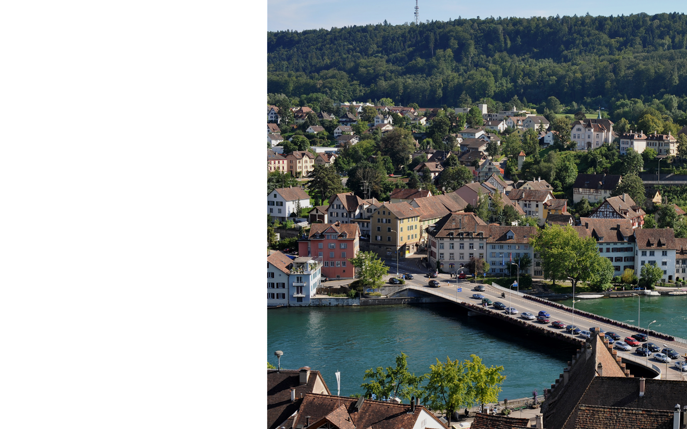

The World around us

Slide 3
The world is getting more Urban.
People are becoming more Mobile
The World around us
Technology trend moves toward Smart City. Intelligent Parking is a part of it!
The average number of cars for 1000 inhabitants constantly grows
750 in USA,
500 in the countries of European Uinion
250 in Eastern Europe.
Number of cars in Kiev exceeded 1 mln, that is more then 350 cars for 1000 inhabitants.
Regulated parking space in municipalities of EPA countries is estimated to be more then 40 mln spaces: 35% on-street and 65% off-street. But in many city zones there is greater demand for the parking space then availability.
The parking space in cities of Eastern Europe is mostly not regulated. But it is not sufficient.

Slide 4
The world is getting more Urban.
People are becoming more Mobile
The World around us
Mobile phones have become ingrained in our everyday lives!
The average percentage of smartphones penetration in Western Europe reached 55%, in most of the countries it exeeded 60% of population.
In most countries of Eastern Europe this number is more then 40%.
The penetration of smart phones in Ukraine reached almost 30%

Slide 5
Every car trip begins and ends in a parking space!
The World around us
Parking regulation is one of the best ways to regulate car use.
95% of its lifetime car is parked
On average, 30% of the cars in congested traffic were cruising for parking.
The average time to find a curb space in EU is about 6 min with a distance at 1,2 km. That creates 39 tons of CO2 per 1000 cars per year!
19 500 tons of CO2 per year are produced in the city with population of 1 mln!
The average time to find a curb space in a big city (like London) is about 20 min!!
Typical behavior of householders – oppose charging anything for curb parking. Although 30% of householders don’t own cars.
Most municipalities do not analyze the parking occupancy and do not change parking fees respectively
The city uses all the parking revenue to subsidize public transport instead of correct management of parking space

Slide 6
Every car trip begins and ends in a parking space!
The World around us
Parking regulation is one of the best ways to regulate car use.
Typical behavior of householders – oppose charging anything for curb parking. Although 30% of householders don’t own cars.
Most municipalities do not analyze the parking occupancy and do not change parking fees respectively
The city uses all the parking revenue to subsidize public transport instead of paying proper attention to the regulation of parking space

Slide 7
On whom the parking policies depend
What smart parking should be
Municipalities «Experts» (USA, most European countries)
Strong points:
The parking space is highly developed
Enforcement is effective
The precise regulation and Law are in force
Weak points:
The significant investments into parking space equipment were made
Municipalities are considering the new Smart City technologies but they are conservative towards new software tools of parking control and management as well as in respect of the parking price and conditions changes.

Slide 8
On whom the parking policies depend
What smart parking should be
Municipalities «Novices» (most Municipalities in Eastern Europe)
Weak points:
The parking space is badly developed and hardly regulated.
Cash is the only applied payment possibility
Enforcement is difficult and even impossible
The proper regulation or Law does not exist
Municipalities in most cases do not invest into equipment, do not analyze the parking occupancy. The streets are congested with traffic
Strong points:
There is possibility to escape the unnecessary investments and to choose the new way of parking space development.

Slide 9
Changing Parking Policies.
What smart parking should be
Wrong Parking Prices brings bad results
High prices – many vacant spaces, low revenues
Low prices – no vacant spaces, congested traffic
Free curb parking:
small temporary benefit for drivers with a good “parking karma”
large social costs every day
the limited revenue available to pay for public services.

Slide 10
Changing Parking Policies.
What smart parking should be
Time Limits
Most Cities deal with a shortage of curb parking by limiting the time allowed in curb space:
Cities undercharge for curb parking relying on time limits to create turnover.
Highly inefficient in the rationing of parking space.*)
If no one wants to park more than the allotted time, the regulation has no effect!
If someone has an urgent need the time limit shall cause extra cruising while searching the new space
Difficult to enforce (more than half of all cars violate the time limit) Example: In Seattle a study of on-street parking in 35 areas found that the average parking duration in space with a one-hour time limit was 2.1 hours. Seattle Strategic Planning Office (2000)
*) Columbia University economist and Nobel Laureate, William Vickrey research

Slide 11
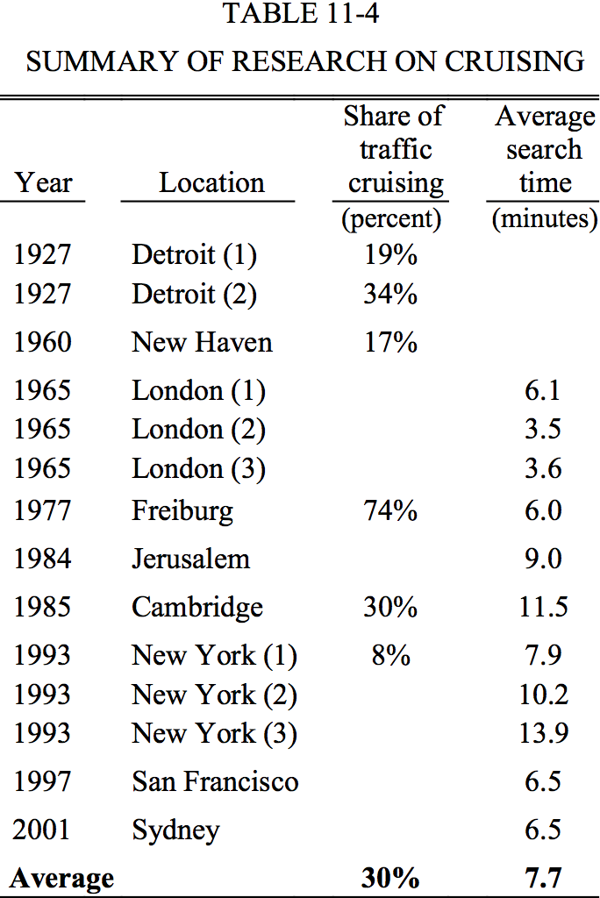
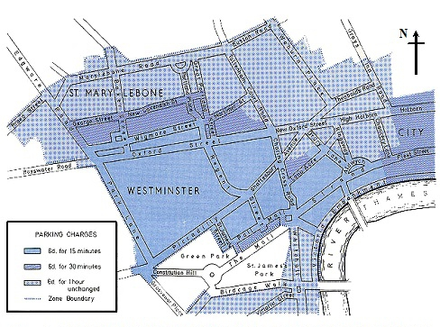
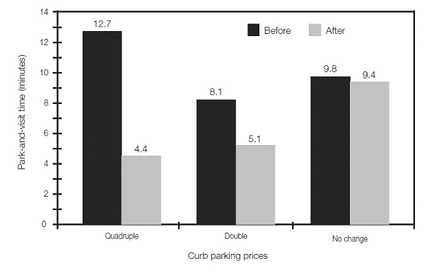
Changing Parking Policies.
What smart parking should be
The Right Price
What is the Right Price (RP)?
RP balance the demand, which varies over time with the fixed supply of curb spaces.
RP minimize the cruising time, drivers will not have to search for a parking space.
City receives the revenue resulting from efficient management.
With the RP there is no need in time limits as a way to create parking turnover.

Slide 12
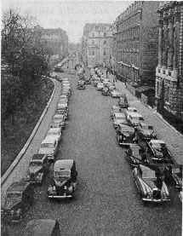
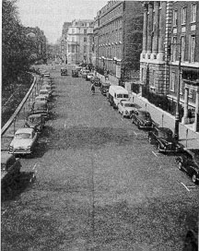
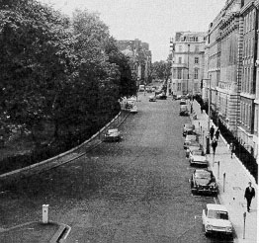
Changing Parking Policies.
What smart parking should be
The Right Price
The effects of parking prices on Grosvenor Square in London
No meters
Meters
The Right Price

Slide 13
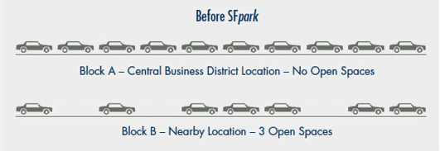
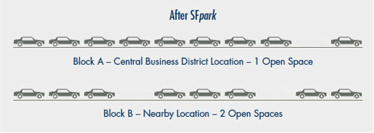
Changing Parking Policies.
What smart parking should be
The Right Price
Wrong price for curb parking in Block A
Nudging up the price on crowded Block A.
Shift one car to less crowded Block B
Lead to big improvement in transportation efficiency

Slide 14
Changing Parking Policies.
What smart parking should be
We believe you can park anytime anywhere
GOLDILOCKS principle – 85% occupancy rate (one of every eight curb spaces are available)
Curb parking performs efficiently: - remains available - well used
Transportation system performs efficiently: - no congested traffic - no waste fuel - less pollution - no waste of drivers time
The Economy performs efficiently.
Right parking price - the gift of good parking karma for all drivers!!!
Right Price can vary frequently enough to avoid chronic shortages or underuse.
The purpose of Right-Priced curb parking is not to maximize revenues. Revenue should not be the primary goal, it should result from good management.
Right Price balance the competing goals of ready availability and high occupancy.

Slide 15
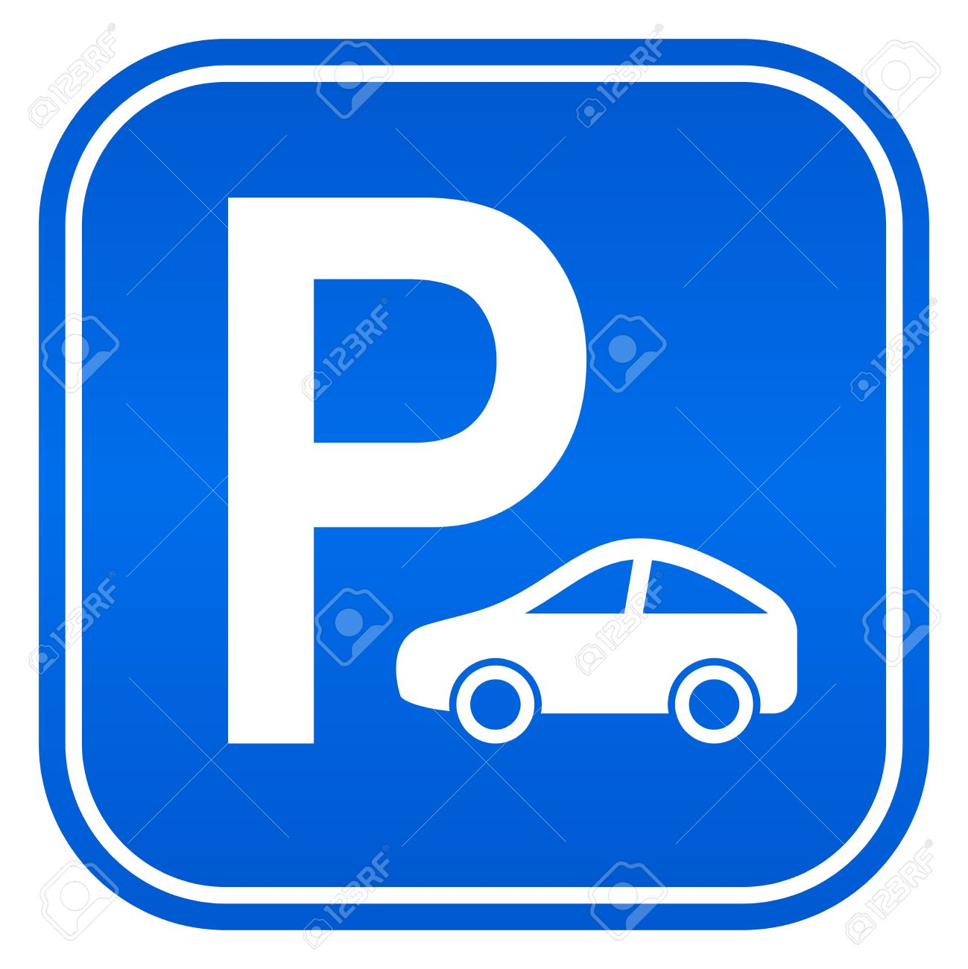
Changing Parking Policies.
I. Look to see if your lot is full or empty
What smart parking should be
Right Price
RP is the lowest price that will avoid shortages.
IV. If you are empty and they are full, lower your price
Traditional four-step process to set the RP
II. Check your competition
III. If you are full and they are empty, raise your price

Slide 16
Changing Parking Policies.
What smart parking should be
The Right Price
The Right Pricing does not mean that travel will become unaffordable.
As drivers adapt to the higher money cost of parking and the lower time cost of driving:
They can reduce the parking duration.
They can carpool and split the cost of parking.
They can park off-street.
They can divert some trips to off-peak hours when parking is cheaper.
They can make more trips by public transit, cycling, and walking.
Each strategy reduces peak-hour parking use. Diverting trips to walking, cycling, vehicles sharing and public transit reduces vehicle travel without reducing human travel.

Slide 17
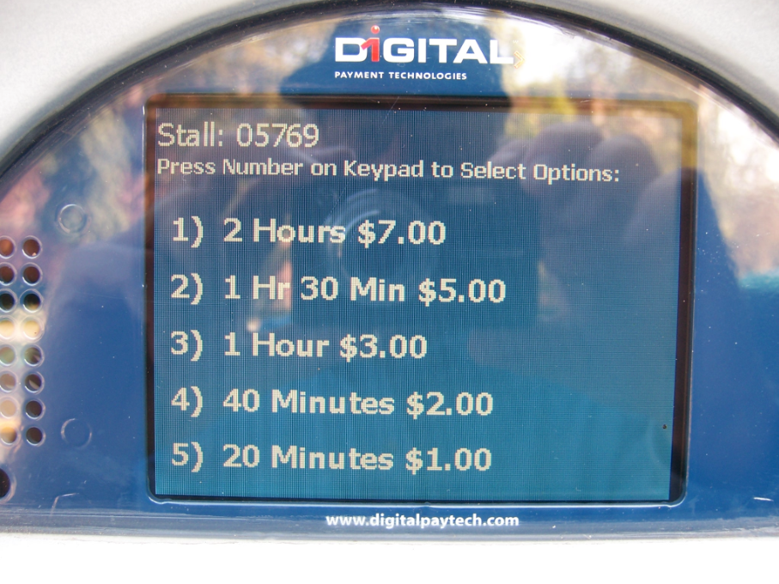
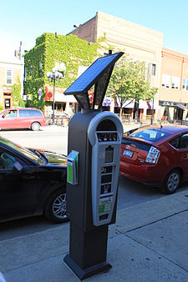
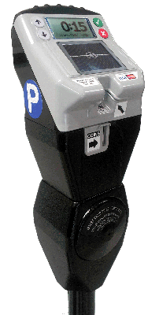

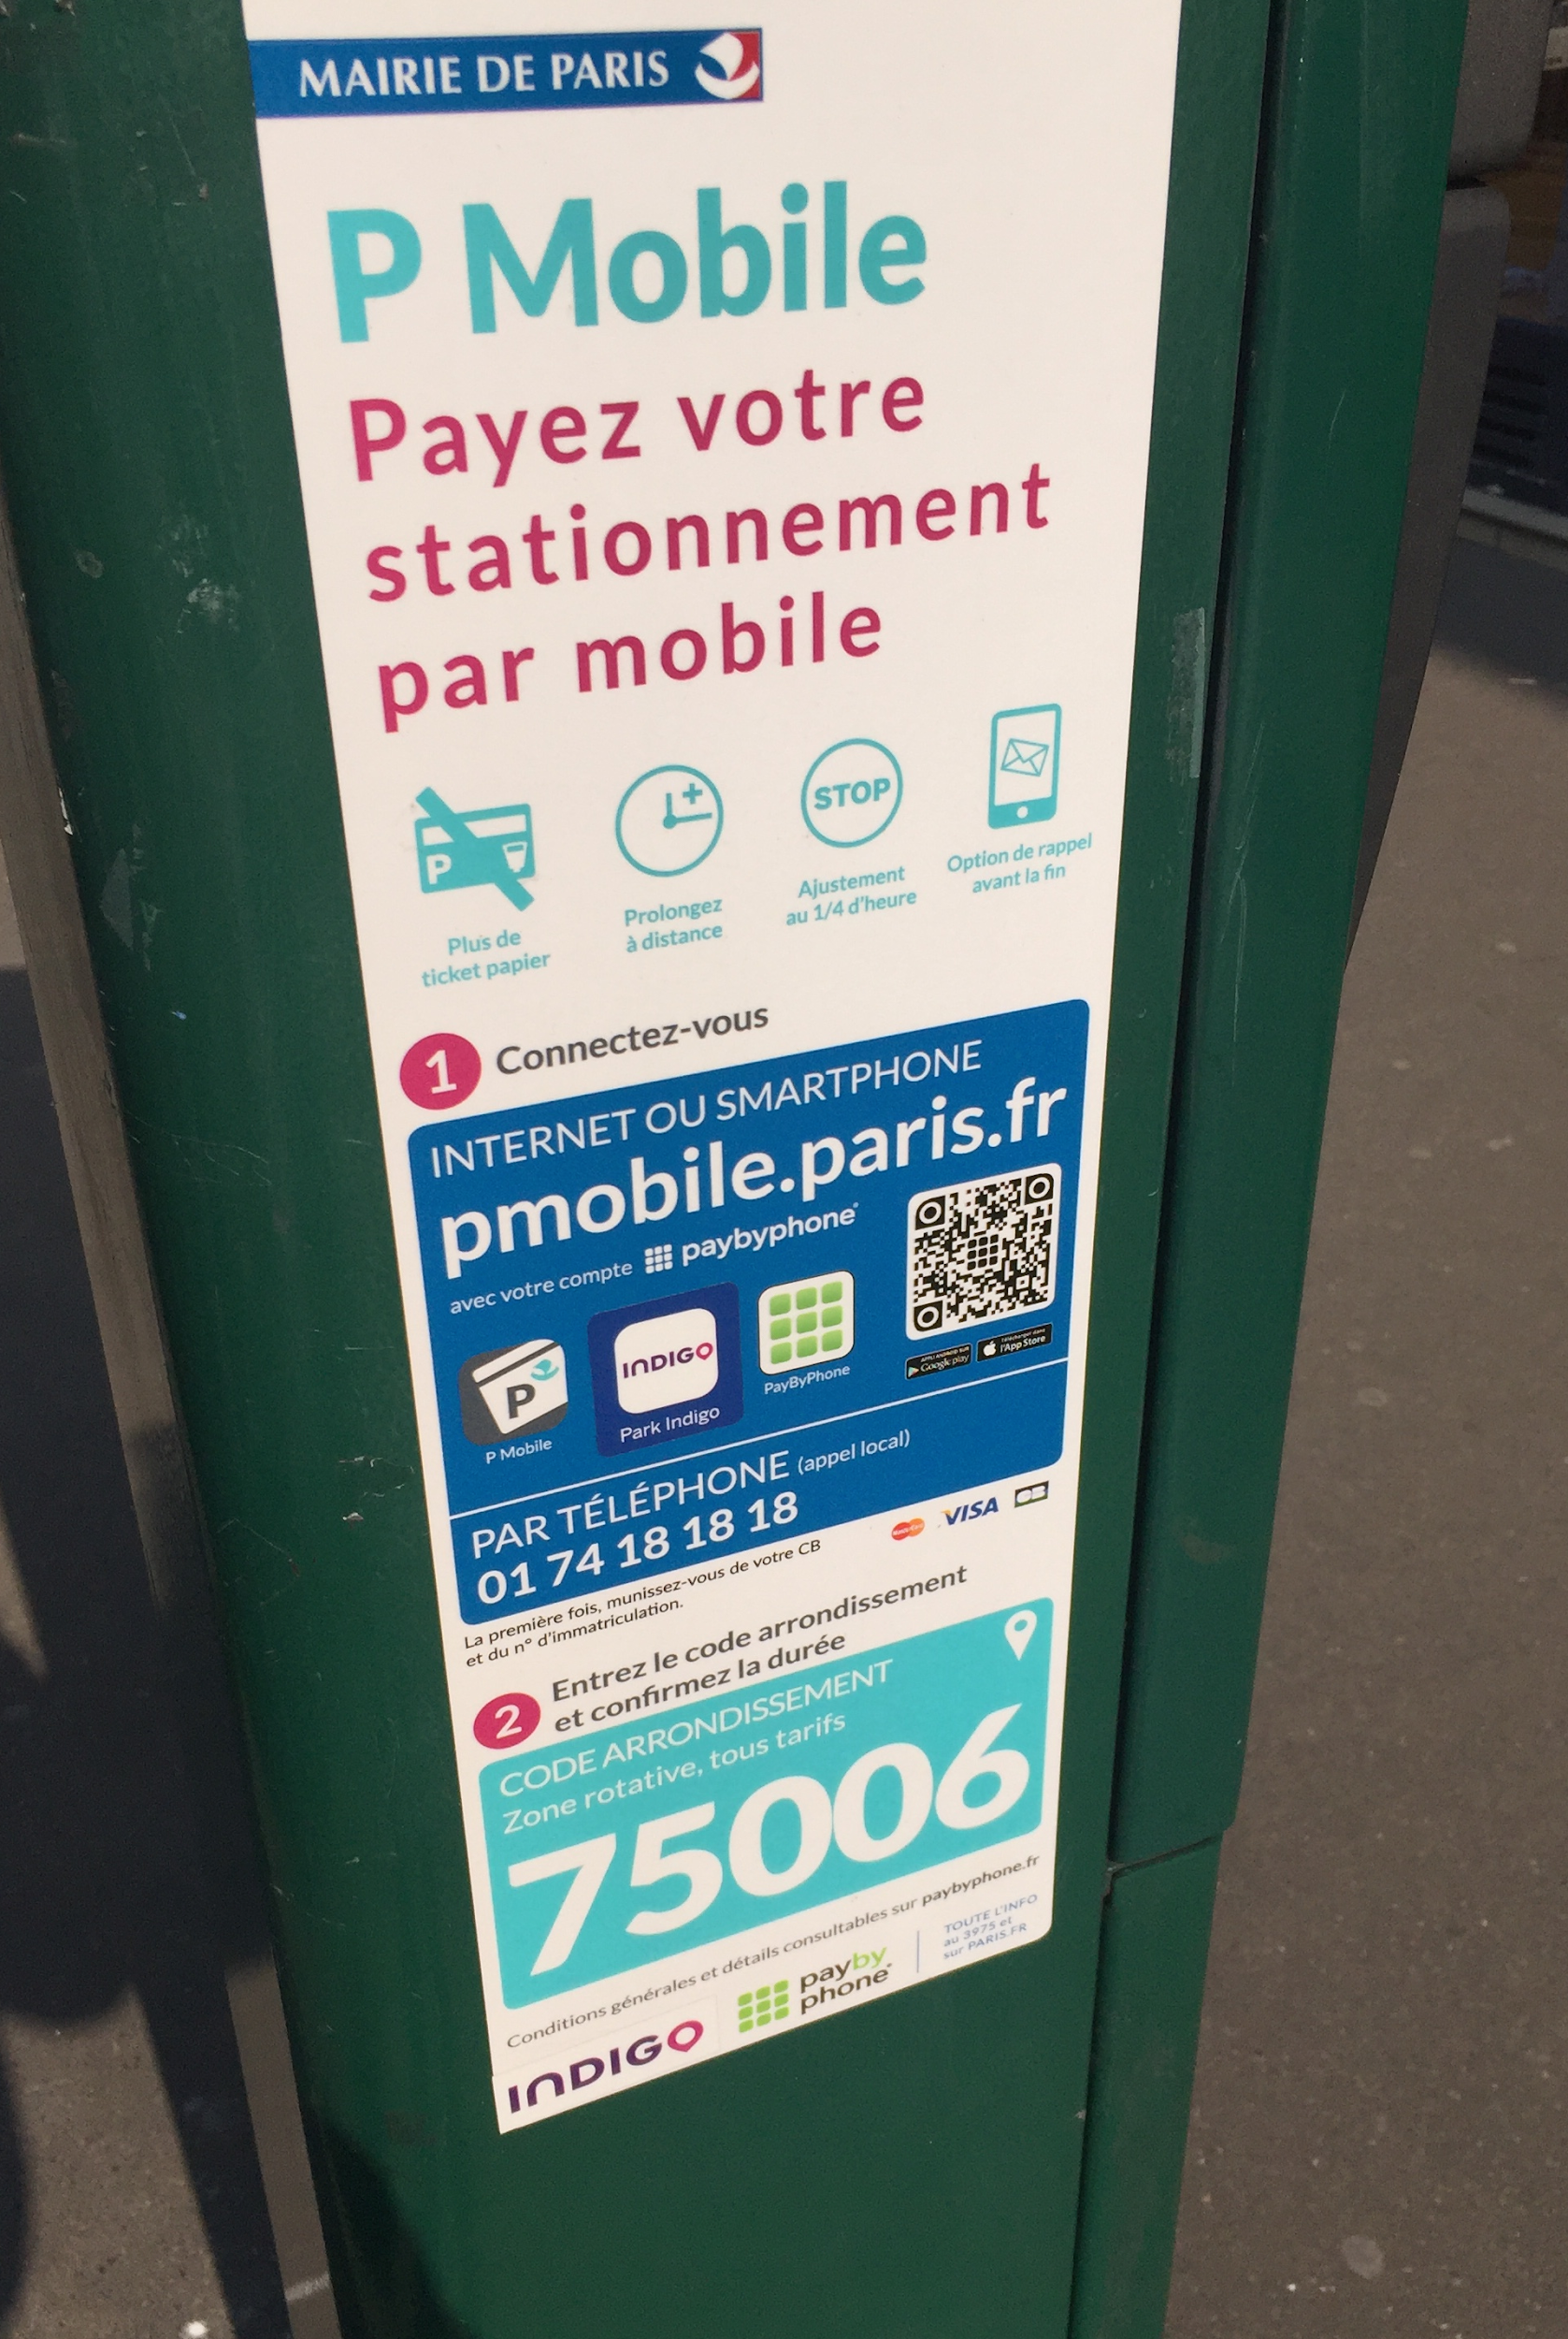

How would the cities charge variable price?
What smart parking should be
Various modern instruments and tools can be used for charging variable price, control over parking space occupancy and drivers notification
Credit Card payment accepting - PA DSS validated
Coin validation technology
Solar panel charged battery with long lasting back battery pack
Remotely monitor and scheduled profile/rate changes
Large front display
Individual parking space sensors that gather and transmits information for management, payment and compliance monitoring
Different SW Parking Platforms

Slide 18
How would the cities charge variable price?
What smart parking should be
Advantages
Variable pricing available
Credit card payment accepting
Screen for driver notification
Disadvantages
No flexibility
No remote payment available
No occupancy and compliance monitoring
No regulation of space availability
Expensive (high cost investment, maintenance and cash collection required)

Slide 19
How would the cities charge variable price?
What smart parking should be
Advantages
Reduce the motorist frustration
Optimize parking utilization
Real time overview of individual parking occupation
Overstay enforcement easy to detect
Disadvantages
Battery required
No regulation of space availability
Investments to the equipment and technical support

Slide 20



How would the cities charge variable price?
What smart parking should be
Advantages
Remote control over parking session
API integration of modern instruments like park meters, sensors, other
Various payment methods availability
Easy to register and to use, navigation and information
Different type of reports
Disadvantages
No Algorithm of Right Price calculation.
Too many different Apps confuse drivers
The occupancy rate is difficult to determine

Slide 21
With UniP you can park anytime anywhere!

Slide 22
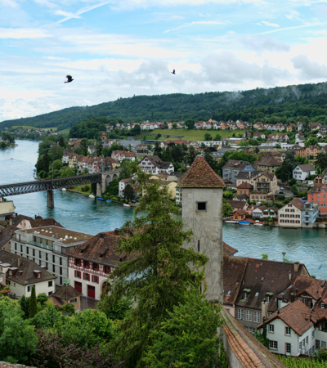

What does UniP mean?
Modern software tool for complete parking management developed for
Municipalities
Private operators
Drivers

Slide 23
UniP Platform
What does UniP mean?
Reliable information system on all type of on/off-street parking worldwide
Simple and unique application for drivers that includes navigation, search, “pay and go” features, user friendly interface and various features for communication and support.
Universal software tool that enables to control and to manage parking for private and public operators.
Parking HUB that secures interoperability of different available resources and platforms worldwide.

Slide 24
UniP Platform
Parking HUB/API integration
Parking meters
Garage gates
Visual API
Sensors, digital signage
EV charges
IoT
Other SW Parking Platforms
Multiple payment instruments
Paypal
Twint
Credit card
Mobile billing
Prepaid invoice
Post-paid invoice
What does UniP mean?
Information system
Drivers database
Parking facilities database
Parking occupancy information
Continuous Information collection
User interface
Mobile application
Self-service web environment
IVR calls
SMS
Support
Management and control
Statistics and reports
Price and revenue management
Dynamic price
Right price calculation
Enforcement management

Slide 25
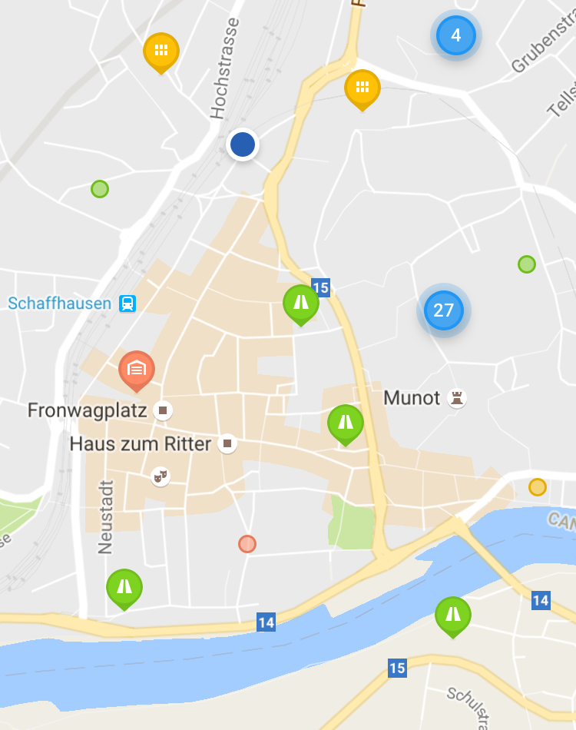
Reliable information system on on/off-street parking worldwide
What does UniP mean?
UniP parking maps give detailed information on any on-street/off-street parking space including price, conditions, limits, occupancy and navigation.
UniP uses the following information sources
Driver provides various information on parking in convenient form.
Municipality provides parking requirements and conditions when controlling and managing parking facilities
Private operator provides information on availability, price, payment conditions
Modern IoT sensor based tools provide information on occupancy

Slide 26
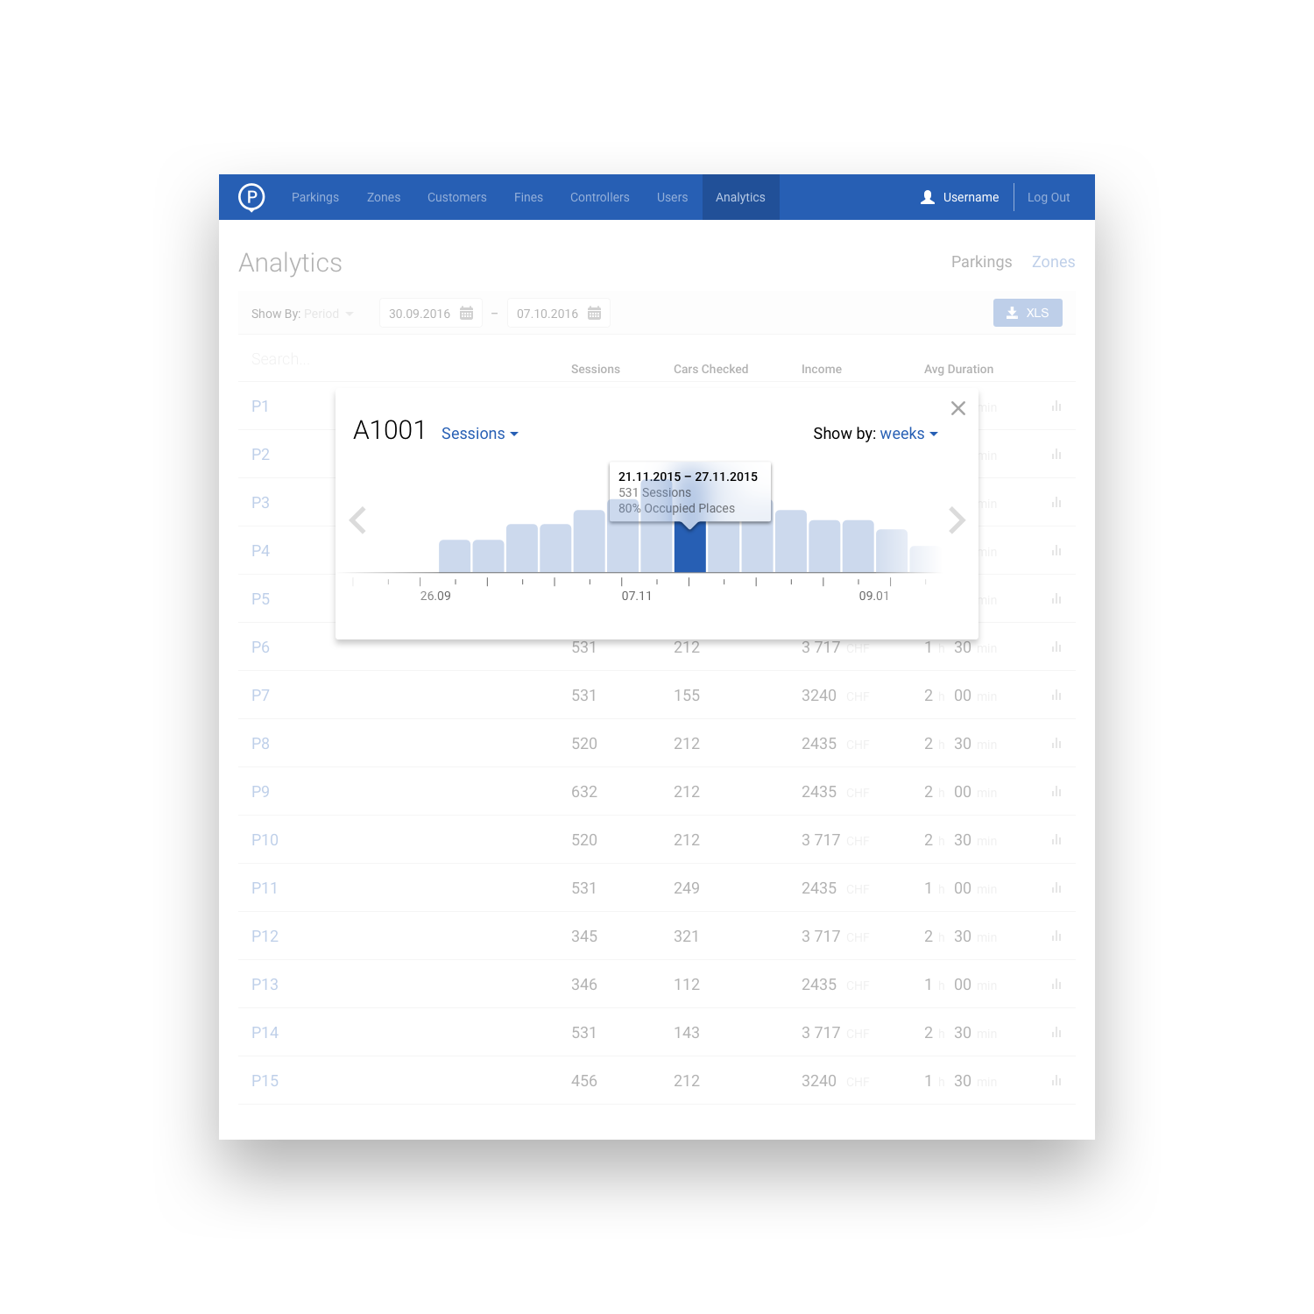
Universal software tool for control and management of parking space-Municipalities
What does UniP mean?
Mobile application, open API, integration with smart park meters and parking occupancy sensors provides the necessary statistic data for the further analysis and correct management decisions.
With UniP you are just three steps away from non-cash payments integration: register, integrate parking facilities into the platform and receive payments. No cash collection, no tickets, less investment in assets and maintenance
Dynamic UniP algorithm helps to calculate the right price, to limit bad traffic and to maintain GOLDILOCKS principle that secures the parking space availability in any site at any time.

Slide 27
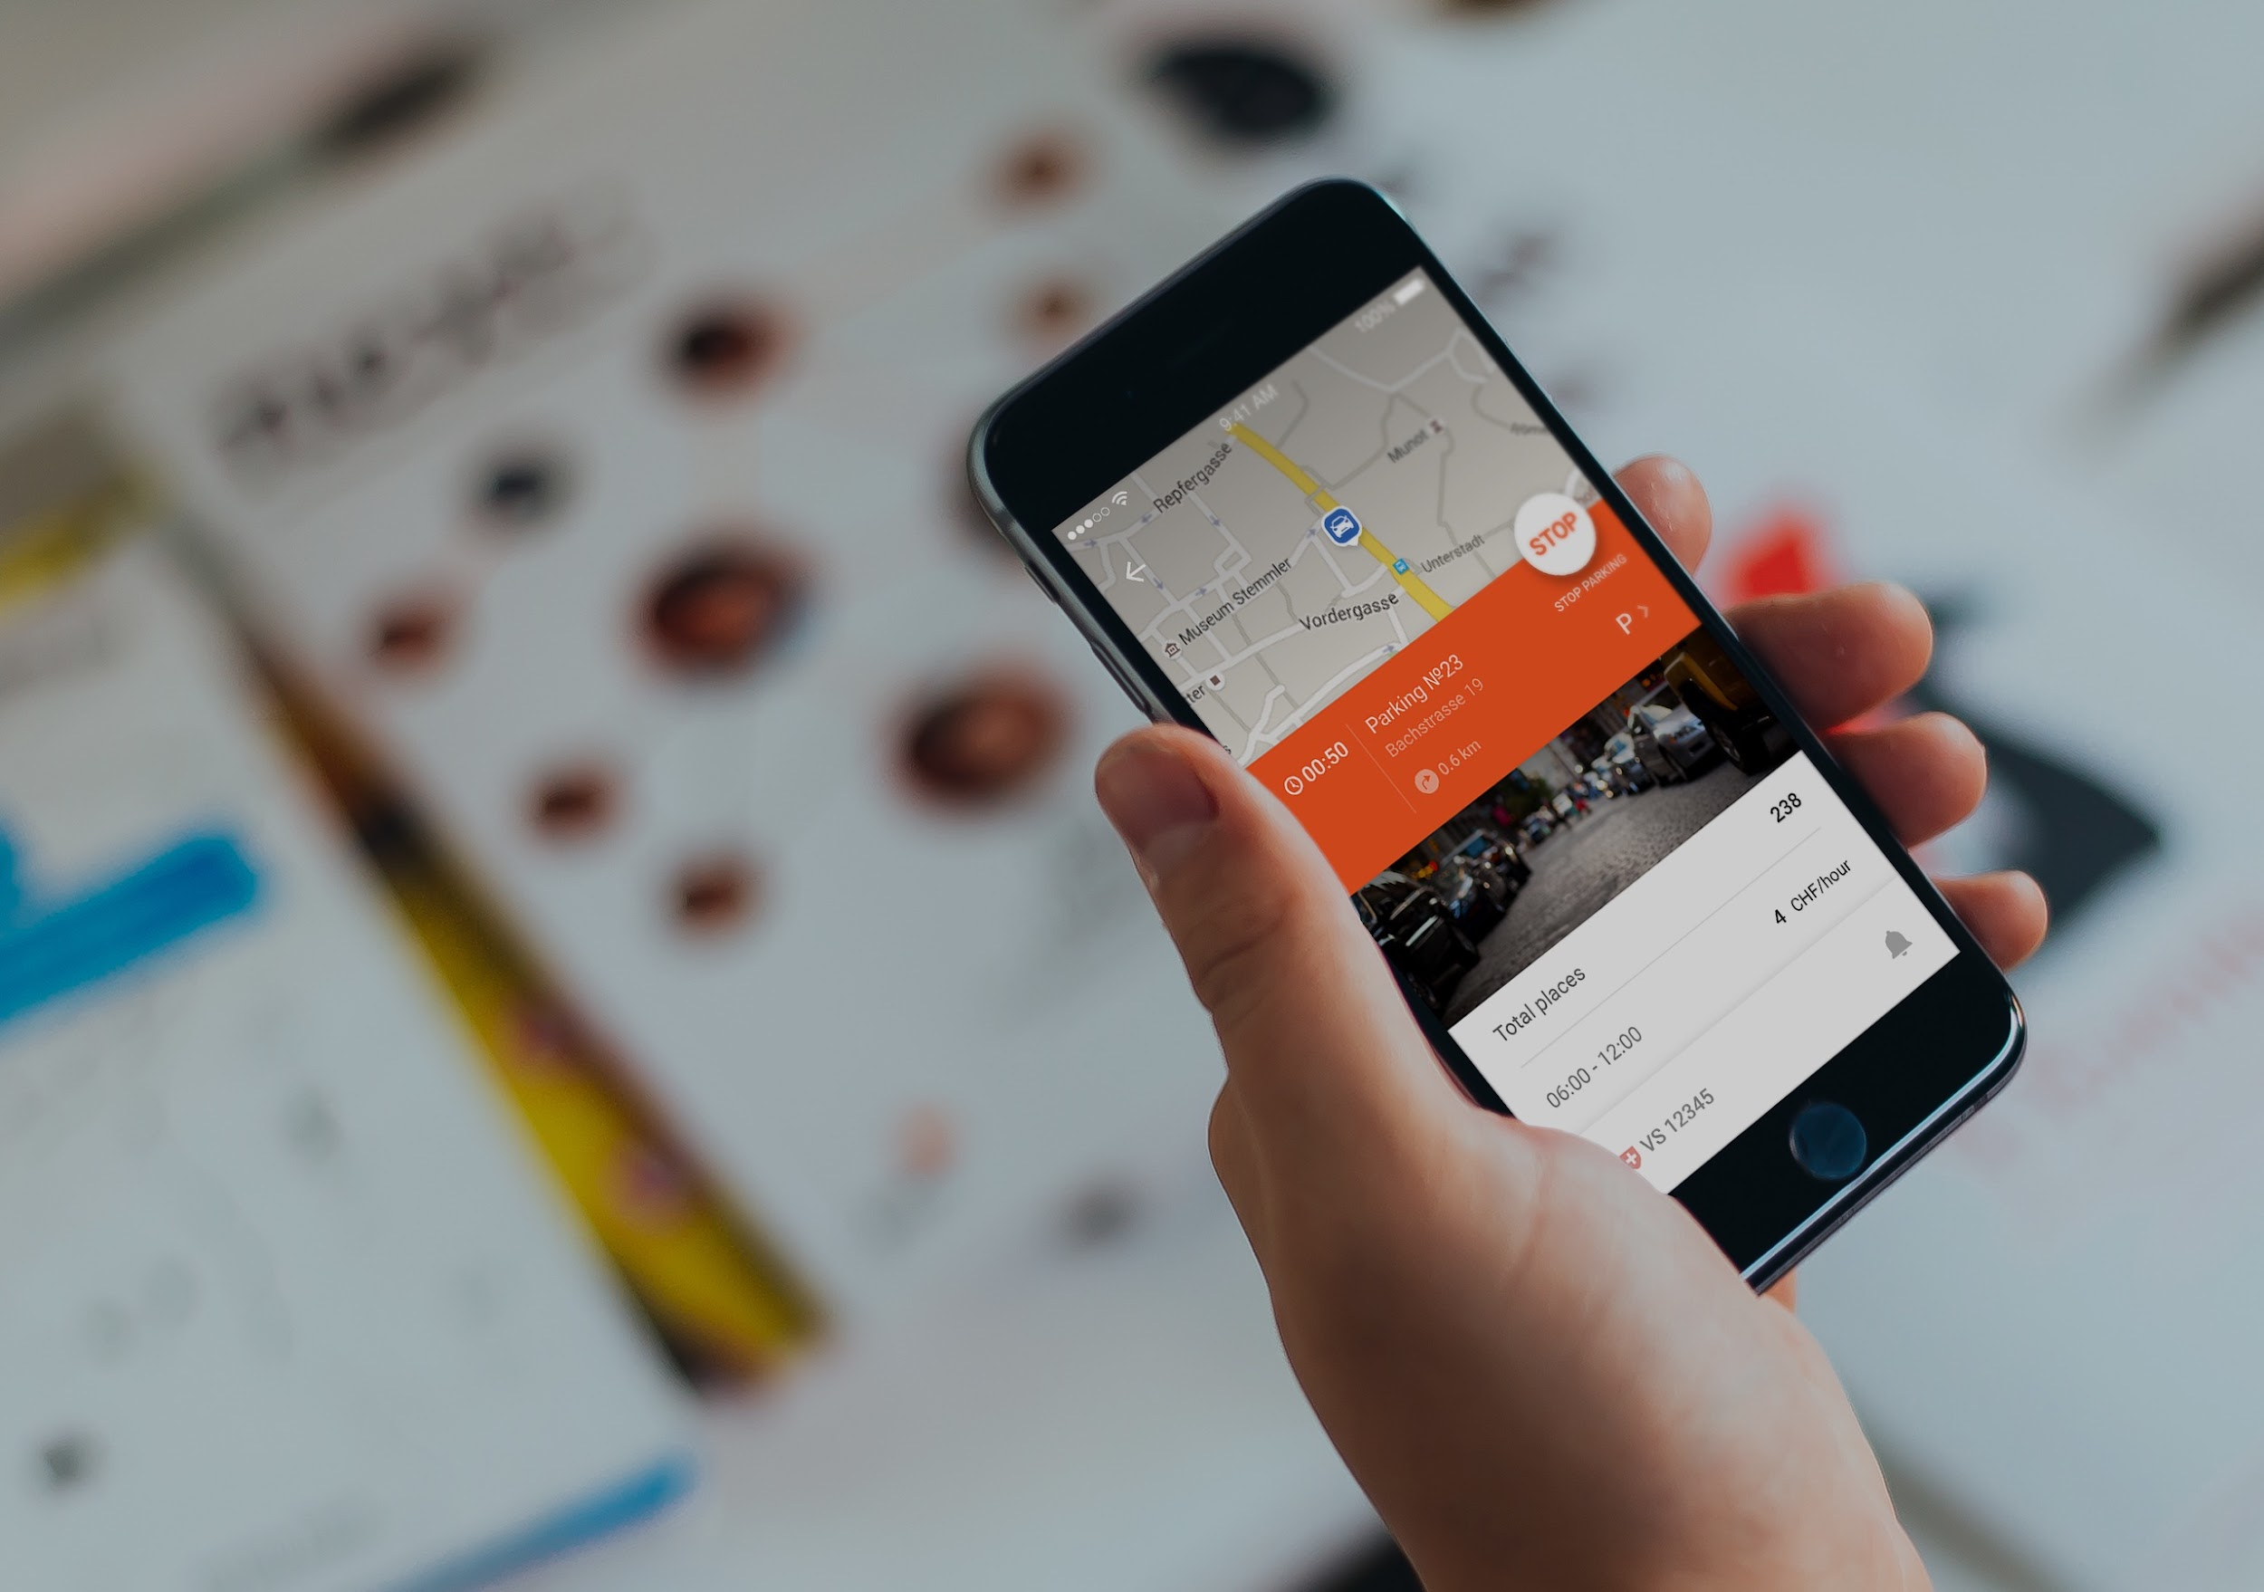
Simple application is not a simple task – but we know how to do it.
What does UniP mean?
One application for all cities. No need to reload an application in every new place and to create multiple accounts. UniP is one service for everyone anywhere!
Remote control over parking session. No need to control parking time, no need to return in order to make the session longer.
Various payment methods including advance and post payment. Various payment tools. No need in coins and tickets. No more queues to parkmeters.
Advanced navigation to the final destination. Detailed maps, calculation of the route to the final destination including walking part, the effective choice of available parking space pricewise. Useful tool for planning the trip.
UniP helps to avoid inforcement
Automatic notification system and direct communication tool

Slide 28
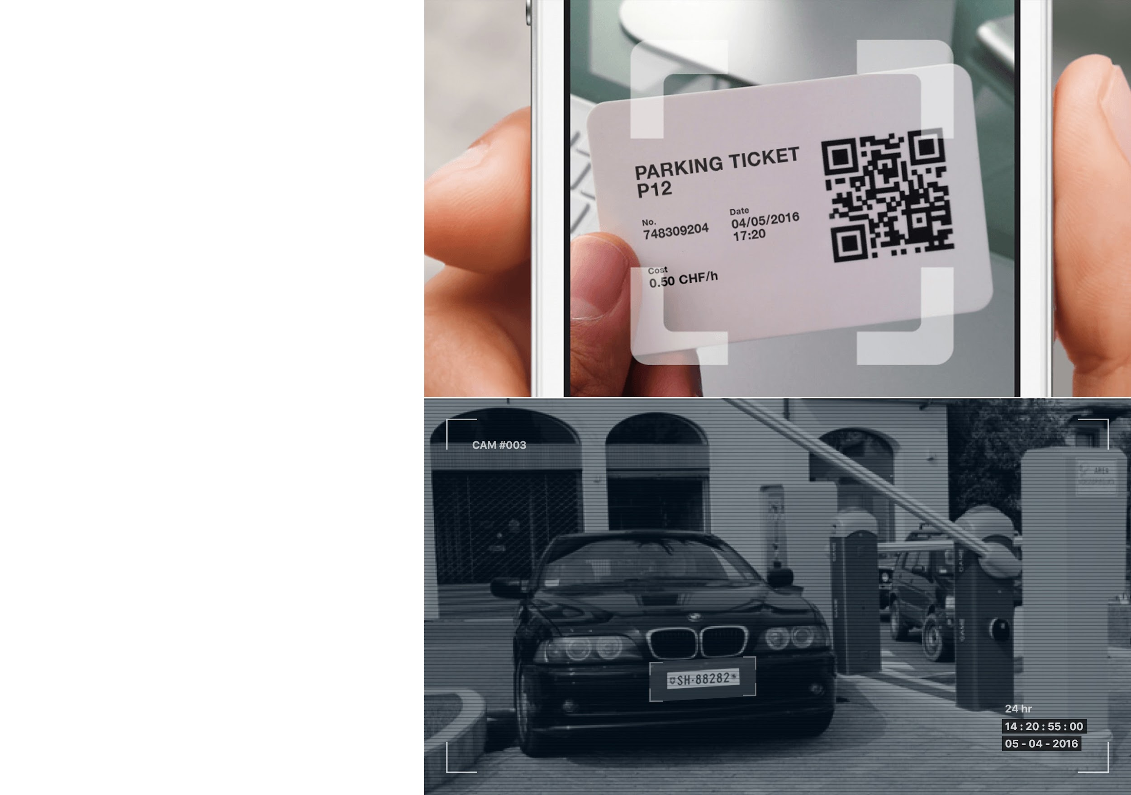
UniP is a parking HUB
UniP
What does UniP mean?
Interoperability of different available resources and platforms worldwide.

Slide 29
UniP – reliable tool calculating the Right Price
What does UniP mean?
Municipality can effectively solve the task of the parking occupancy and traffic optimization. We know how it works!
Algorithm for calculation of the Right Price:
UniP enables to create the database of all carried out parking sessions, as well as to integrate the external data from sensors and smart park meters on transactions not processed by UniP.
Algorithm analyzes the collected data and calculates the parking occupancy in order to determine the parking sites that require applied rate correction in certain intervals of the day
Algorithm increases the parking price in case of high occupancy (more then 85%) in order to motivate drivers to use less occupied parking sites located at walking distance.
Algorithm decreases the parking price in case of low occupancy (less then 50%) in order to motivate drivers to use this parking site
The Right Price is derivative of time and occupancy. Longer occupation of the parking site suppose higher price for service.
The number of daily time periods and related price are determined by Algorithm automatically based on the collected statistic data.

Slide 30
Key issues that we have solution for
Drivers and citizens satisfaction
Revenue and costs management
Municipalities
What smart parking should be
Right parking price and occupancy management
Payment and enforcement management
Billing management
Customer relations management
Assets management

Slide 31
Key issues that we have solution for
Various payment possibilities
Avoid inconveniences
One App for all needs
Drivers
What smart parking should be
Searching possibilities
Navigation to the final
destination
Avoid enforcement
Remote control over parking session
Avoid cruising
Time saving
Prior information:
Prices, conditions and occupancy

Slide 32
Main Functionality of UniP

Slide 33
Main Functionality of UniP Open Platform for Drivers
Time saving tips
Remote extension of parking session: No need to return to the parking site for payment of extra parking time
Accurate prediction of parking space availability: No need to drive around looking for the parking space
Affective search engine of the available parking place closest to the destination point
Navigation to the closest parking space and to the destination point
No need to search for the parking meter or processing machine
No queues to make payment
Parking with a resident parking permit
Convenience
User information availability (city maps, street view, parking rates and rules, news)
Automatic push notification by App, SMS, IVR.
Parking time and price control from any location. Notification about parking time expiration
Multiplatform. Various user interfaces
Fare payment advantages
No cash, no coins
Payment of fare or fine remotely
Top up balance from mobile, WEB, ATM
Convenient billing: various payment instruments, monthly passes, daily tickets, discount programs, discrete payment possibilities (for example payment for every 15 min)
Invoicing by e-mail, SMS, etc

Slide 34
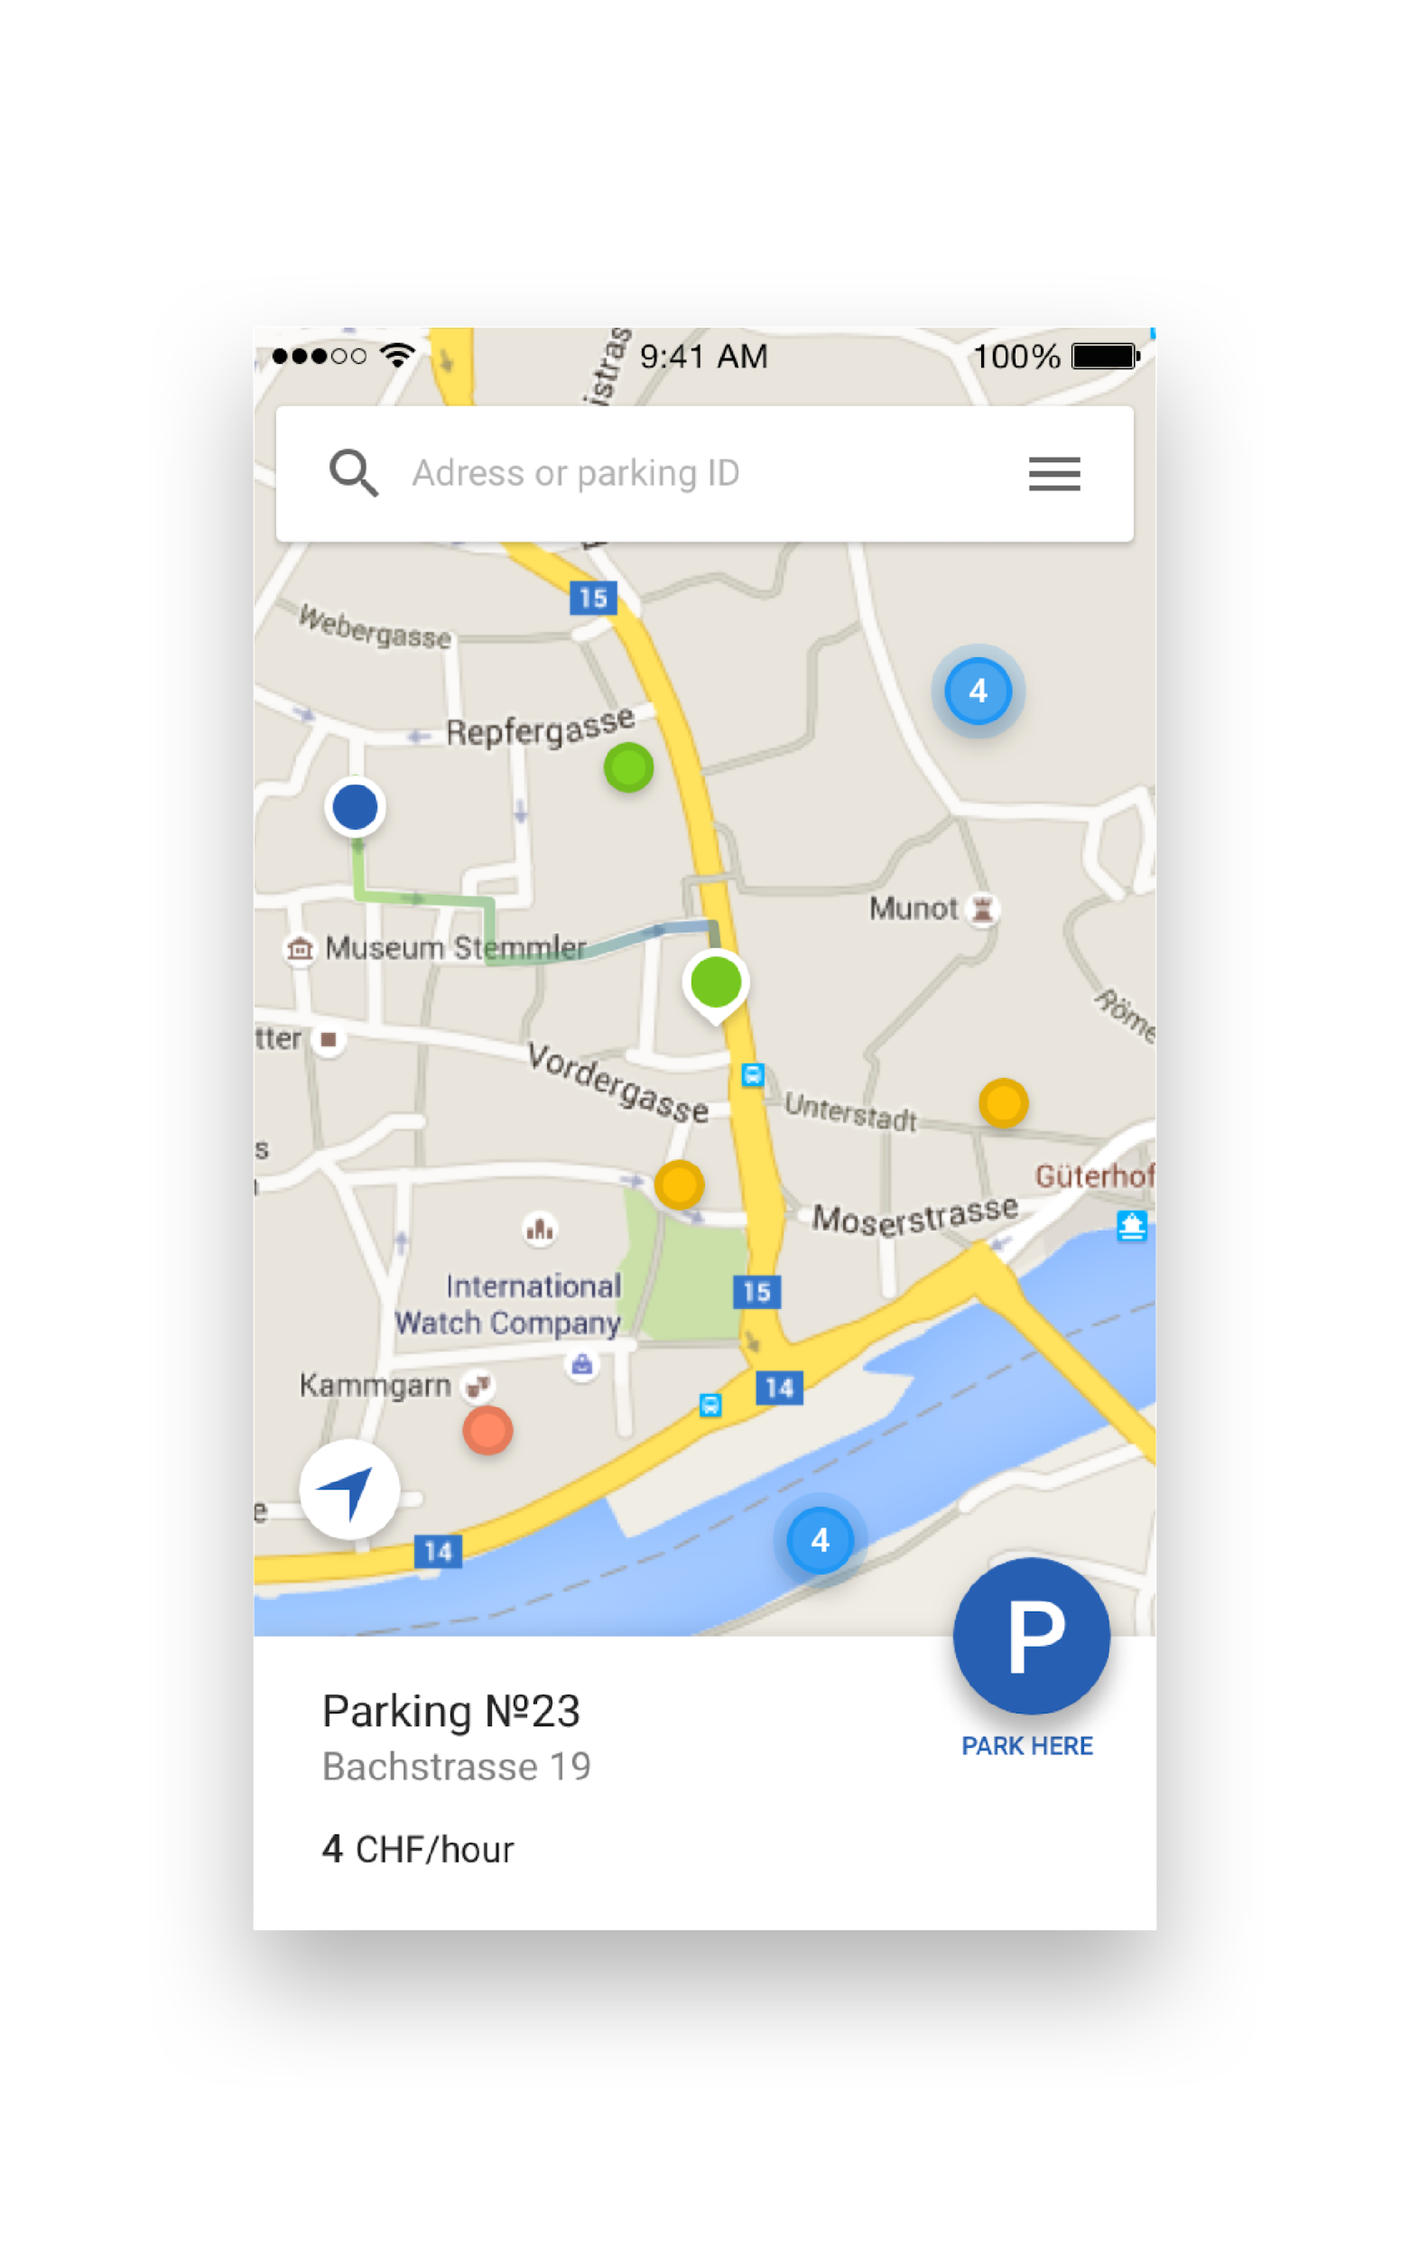
Time saving and convenience
Advantages of UniP for the Client
Comfortable search possibilities
Search available parking and view details on digital parking map of the city

Slide 35
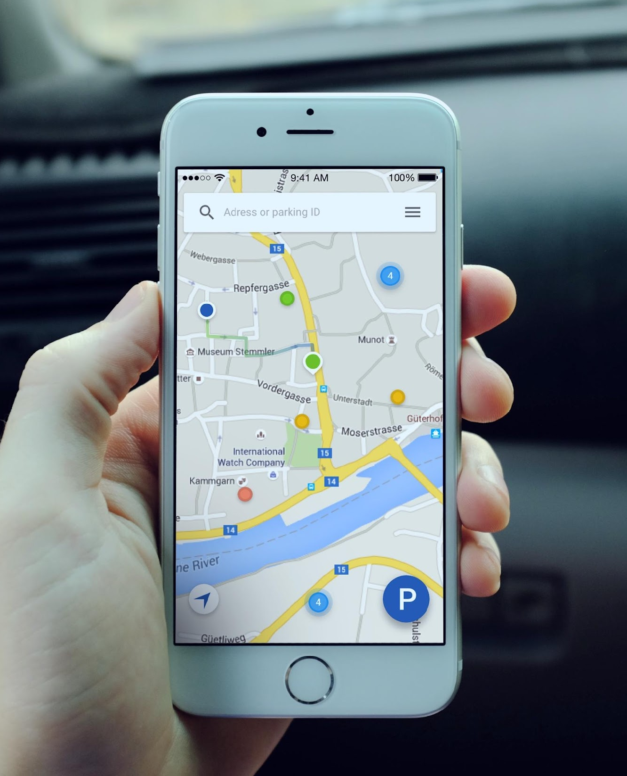
Time saving and convenience
Advantages of UniP for the Client
Accurate prediction of parking space availability
Helps to take early decision where to go based on the parking occupancy information

Slide 36
Time saving and convenience
Advantages of UniP for the Client
Remote extension of parking session
No need to return to the parking for payment for extra parking time

Slide 37
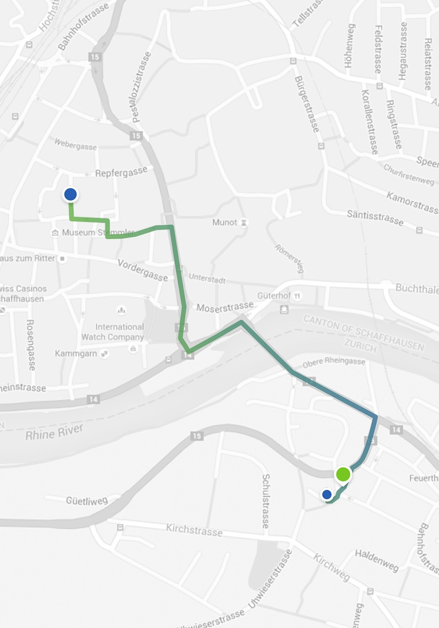
Time saving and convenience
Advantages of UniP for the Client
Route to the parking place
Helps to find the closest parking needed in the shortest time - good navigation till both parking and final destination places

Slide 38
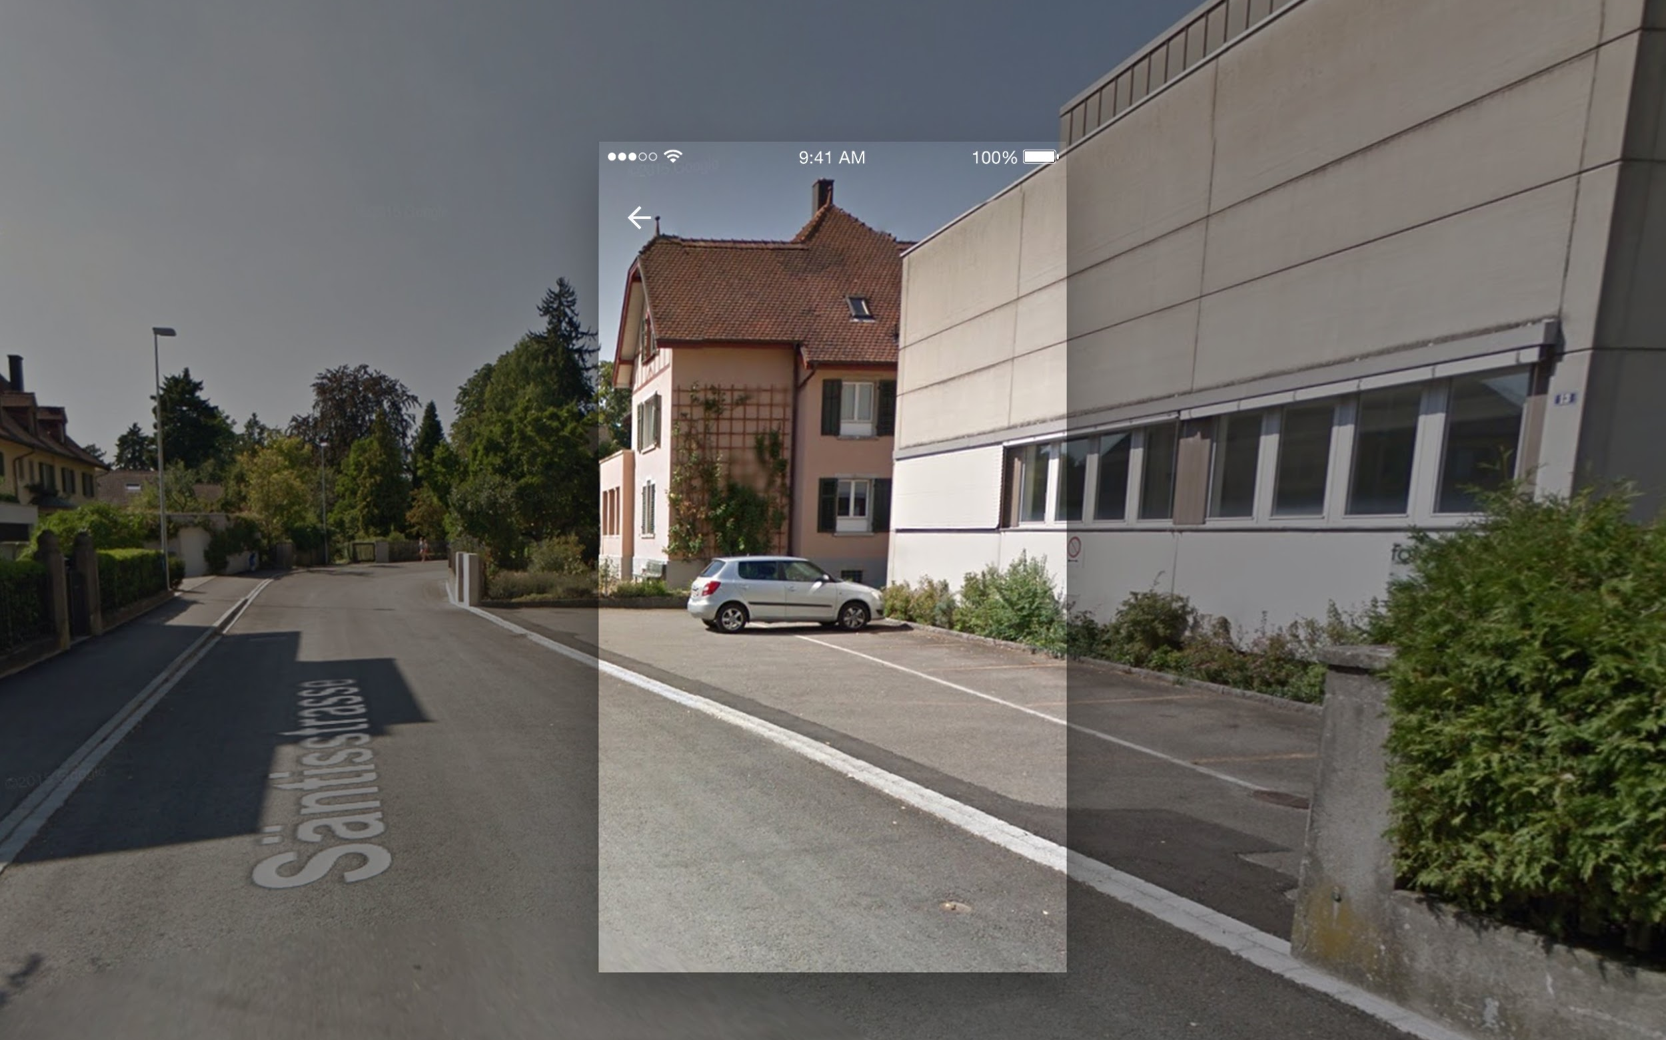
Time saving and convenience
Advantages of UniP for the Client
Street view
View parking place on the streets of the city

Slide 39
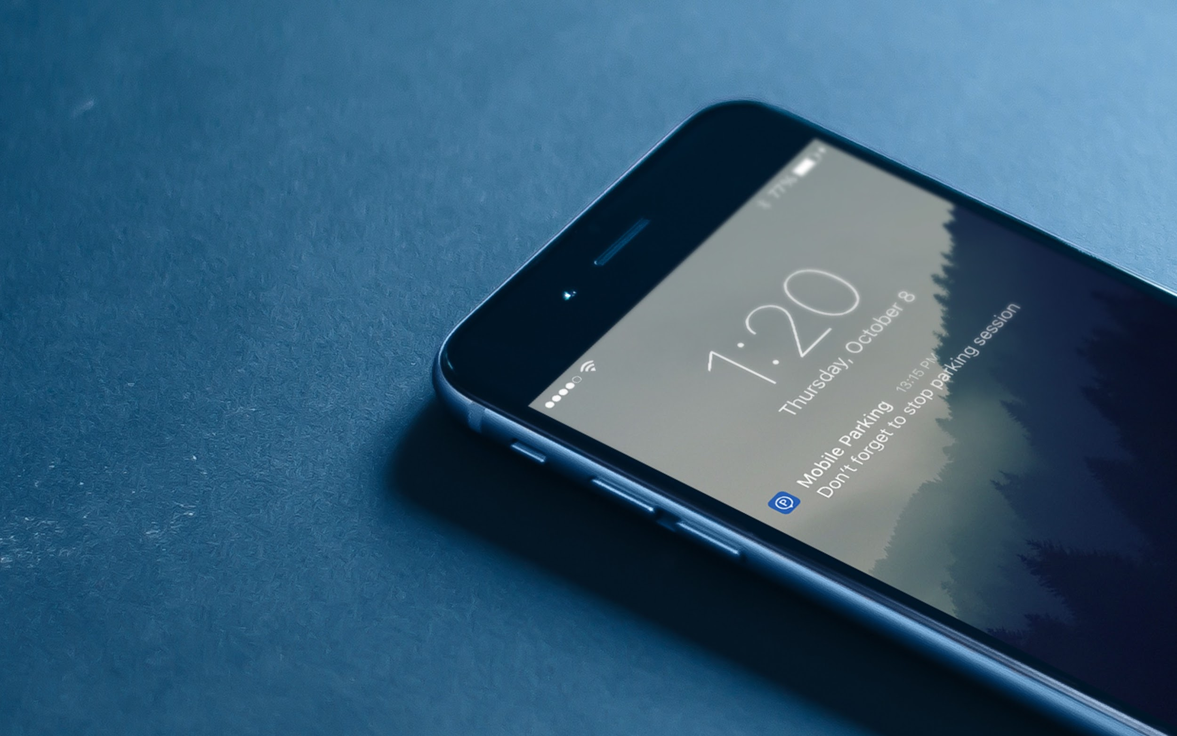
Time saving and convenience
Advantages of UniP for the Client
Flexible notification system
The app will remind you to stop parking session if you moved 1 km away from the place where parking started.
You can also setup a local notification at any time for your parking session in the app.

Slide 40
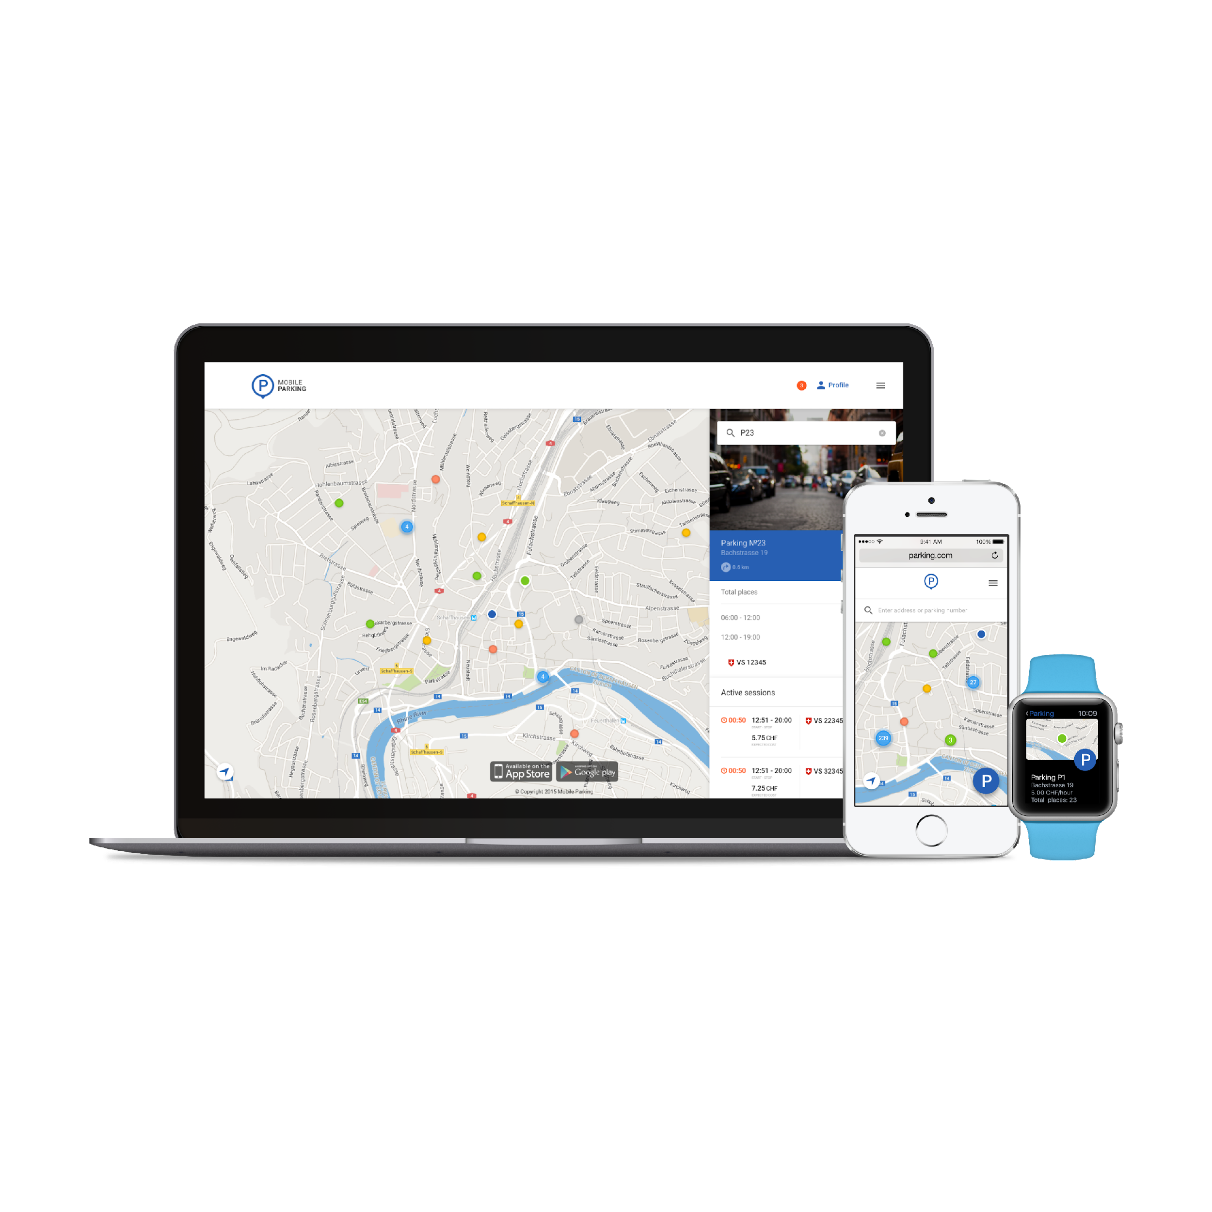
Time saving and convenience
Advantages of UniP for the Client
Multiplatform
The application is available for iOS and Android.
Also you can use all features of mobile application on any mobile browser.
Owners of Apple Watch can use privileges off the app directly from the device.

Slide 41
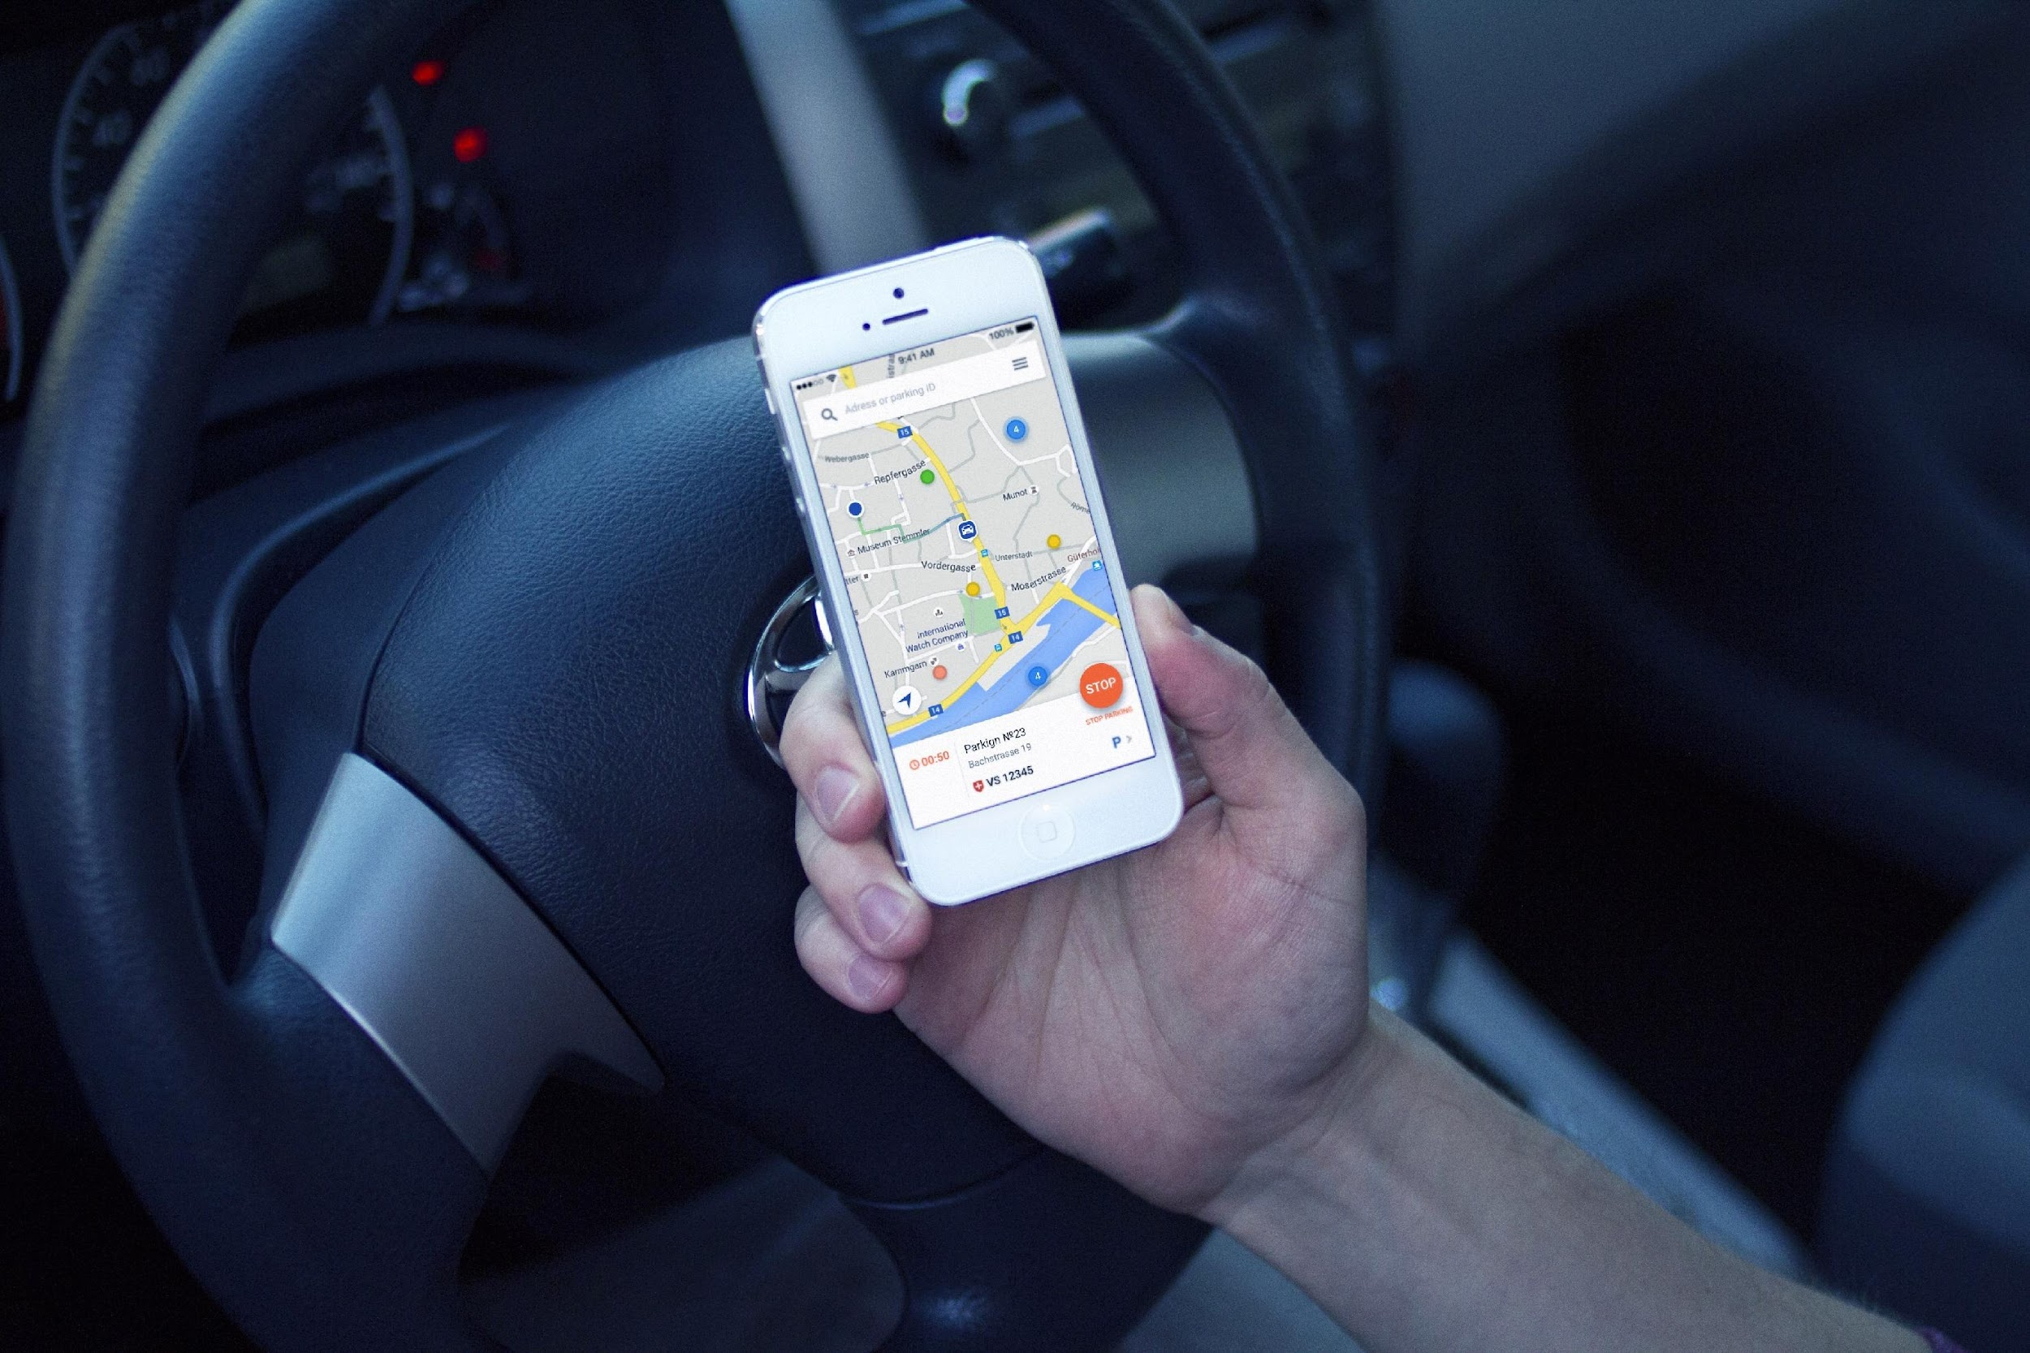
Fare payment
advantages
Advantages of UniP for the Client
Parking time control
Control parking status and price anytime from any location. Get notification about parking time expiration. Escape of fines and enforcement

Slide 42
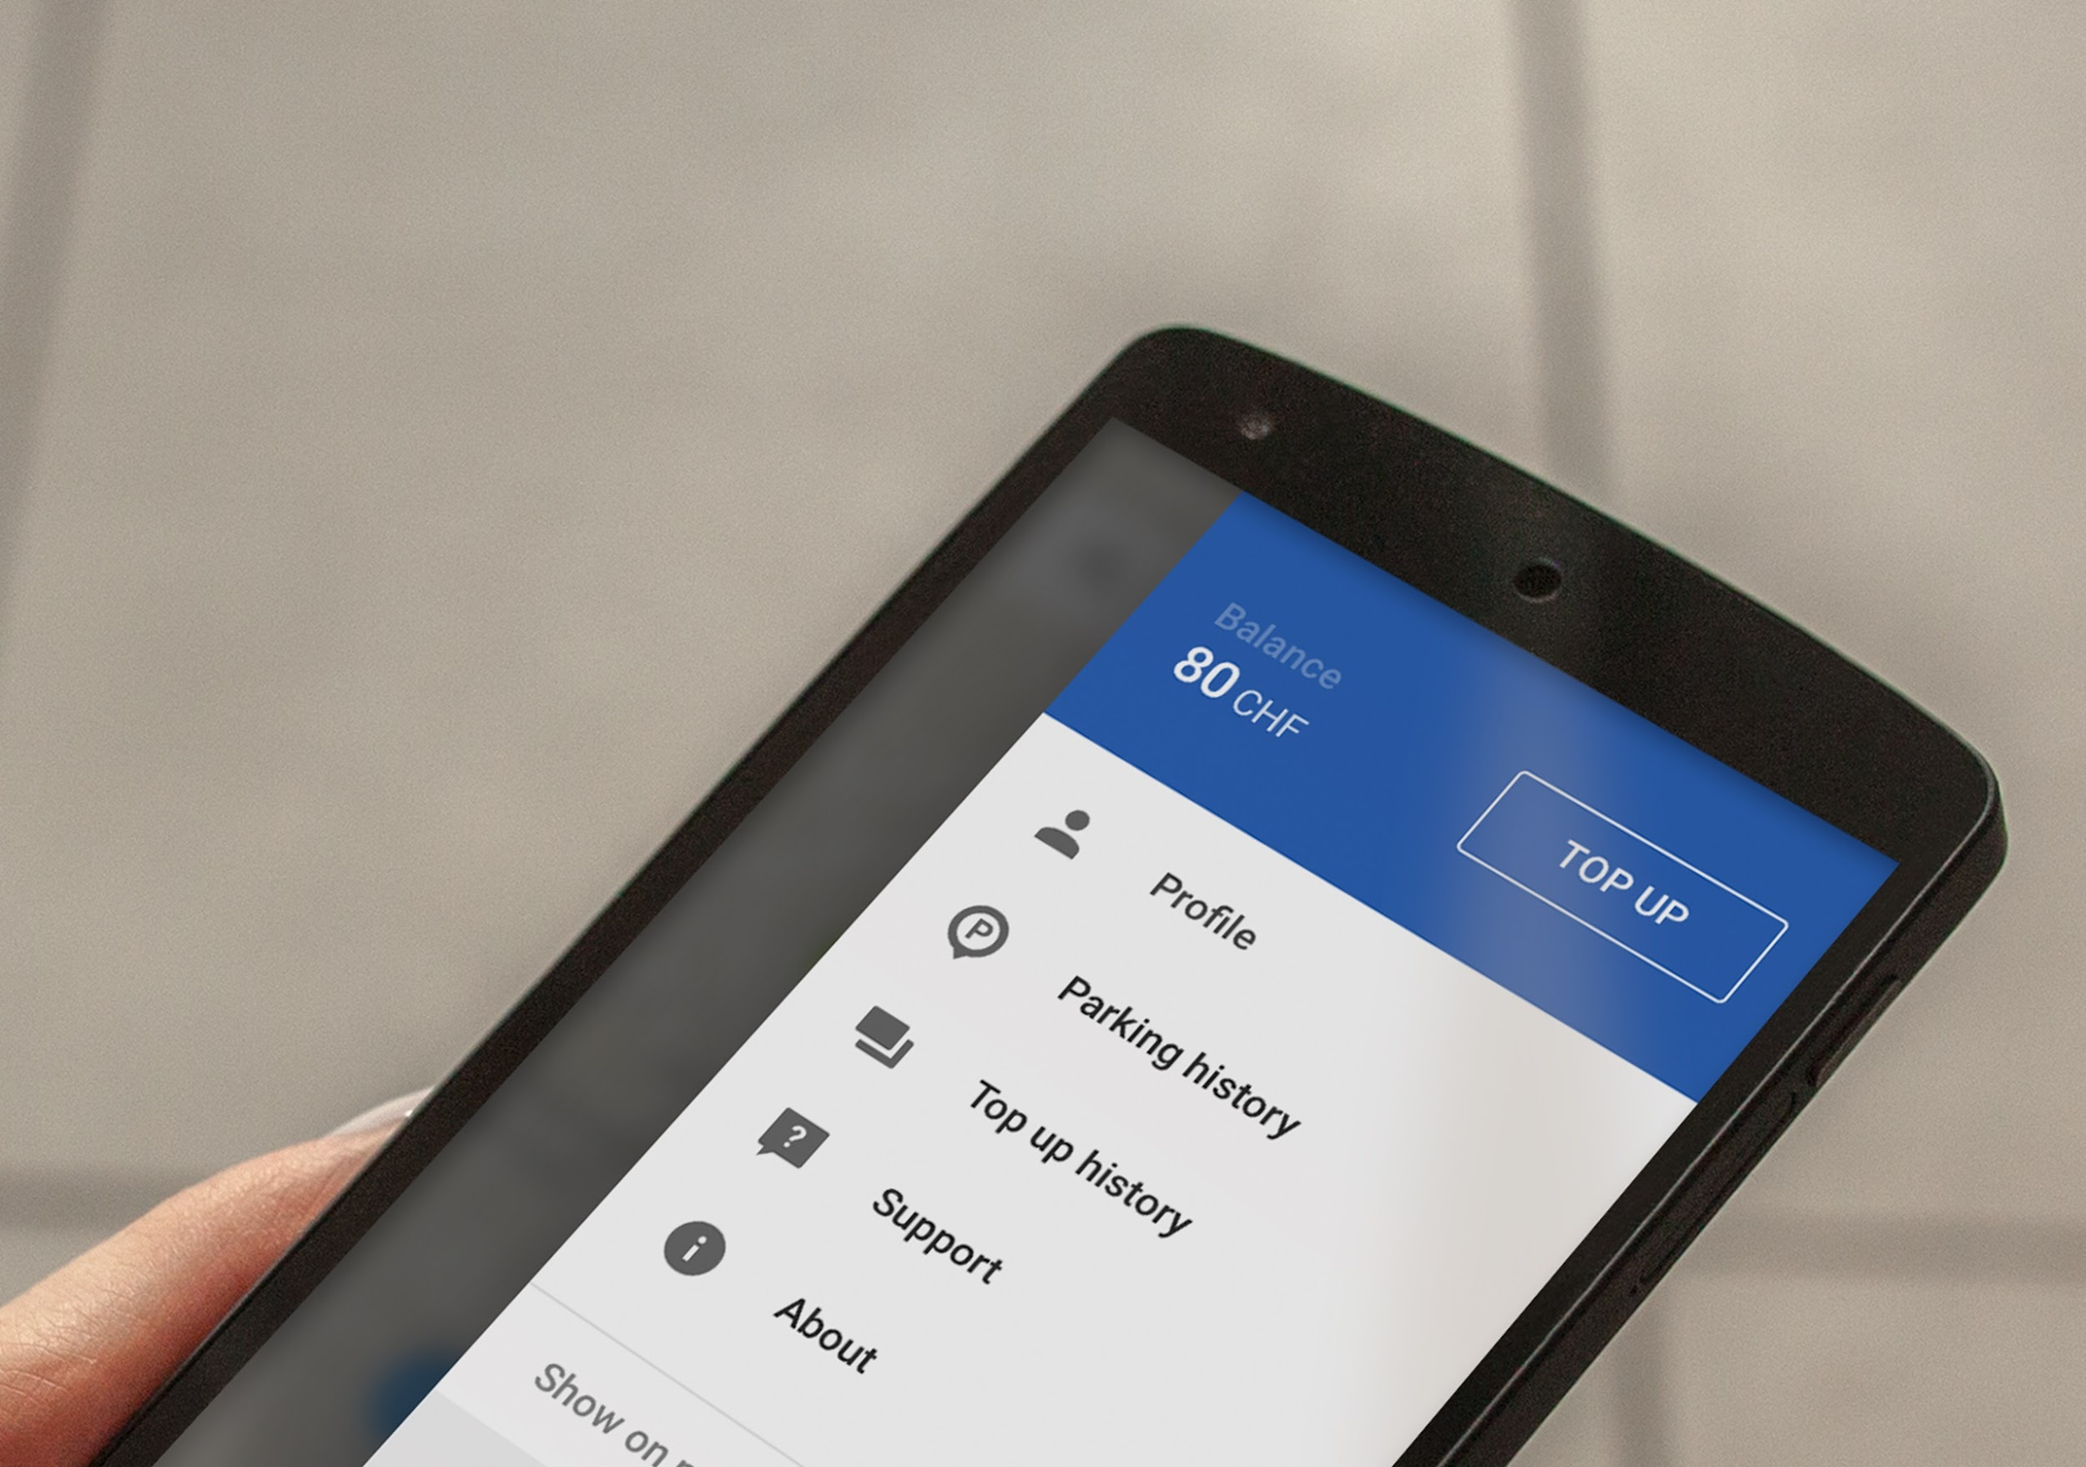
Fare payment
advantages
Advantages of UniP for the Client
Top up balance from mobile phone
Automised fare payment with mobile phone: no coins, no cash, no queues

Slide 43
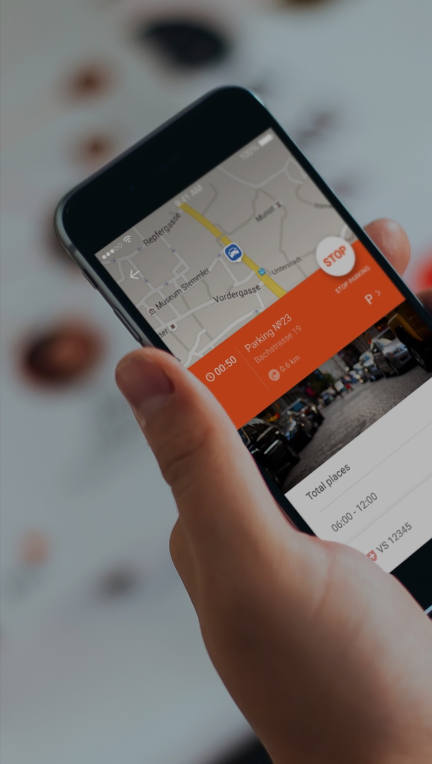
Advantages of UniP for the Client
Accurate prediction of parking space availability
Comfortable search possibilities
Remote extension of parking session
Route to the parking place
Street view
Multiplatform
Parking time control
Top up balance from mobile phone
Flexible notification system
Add money transfer from a dedicated account to another one
SMS parking, if Internet is not working
Single application to pay for all types of parking (public parking lots, private parking lots)
Simple and reliable instruments of payment and top up (PayPal, Google Wallet, Apple Pay, SMS)
Parking via operator
Helpdesk

Slide 44
Main Functionality of UniP Open Platform for Municipalities/Private operators
Customized open interface
Easy registration, intuitive interface
Easy change in Rates and Rules. Dynamic Rates Possibility
Occupancy analysis. Effective rate calculation.
Flexible Reports and Statistics
API Integration
Parking meters/ garage gates
NFC
Occupancy control tools (LORA, NB-IoT)
EV charges
Veloparking and other partner systems
Control equipment and tools
Digital Signage
Monitoring and fines
Automatic detection of car license plate
Photo/video fixation
Special application for the controller
Integration with mobile printer
Automatic driver notification

Slide 45
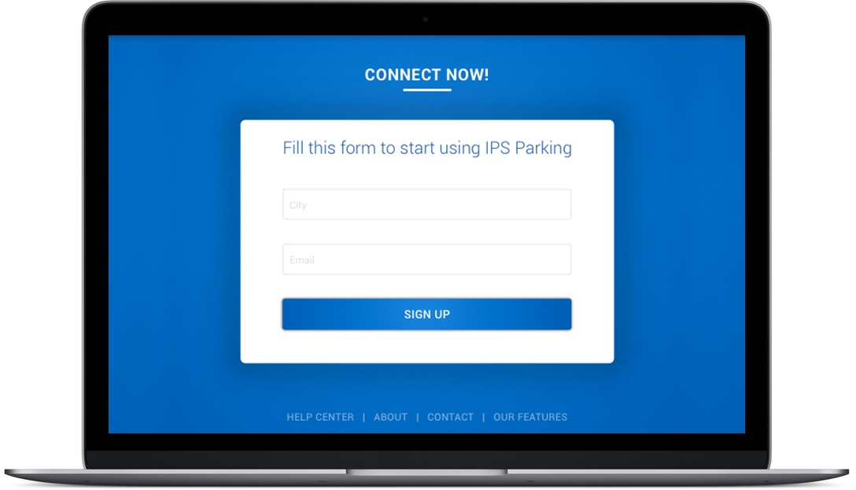
Registration
Main Functionality of the Platform UniP
Convenient and simple registration
Intuitive interface

Slide 46
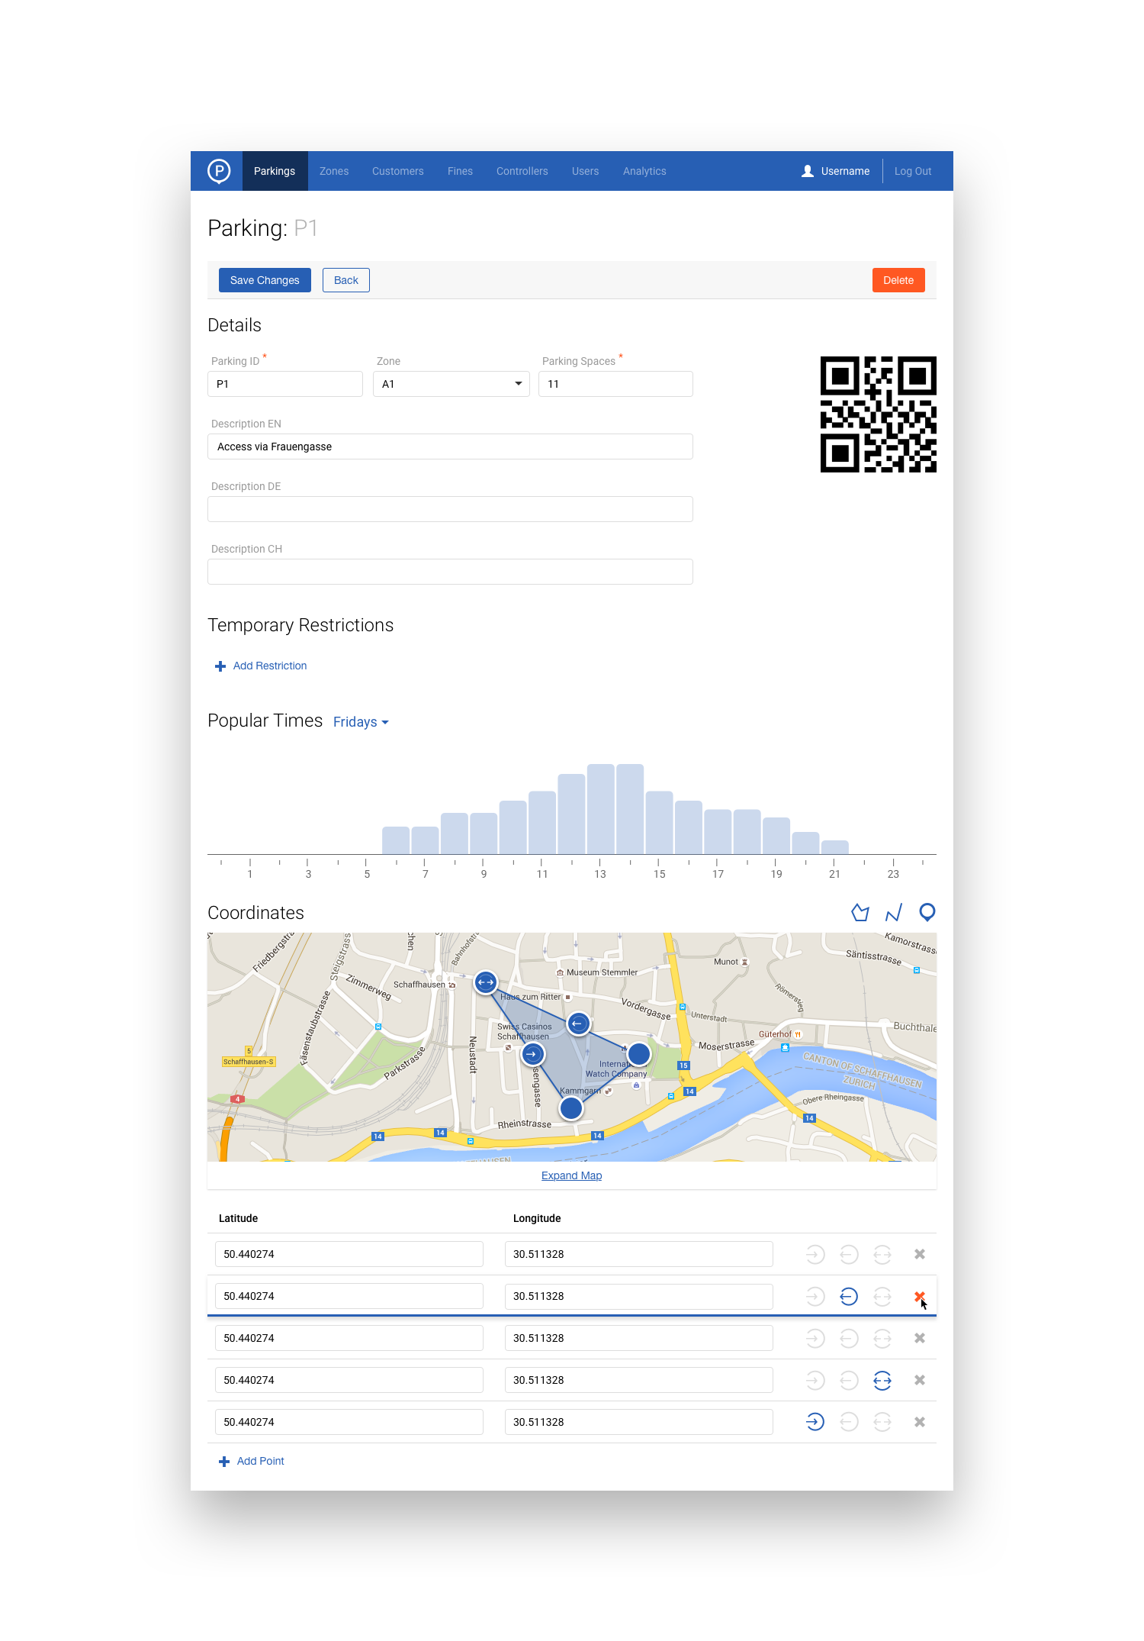
Maps
Main Functionality of the Platform UniP
Simple and convenient method to add all different types (on-street, off-street, garage) of parking on map

Slide 47
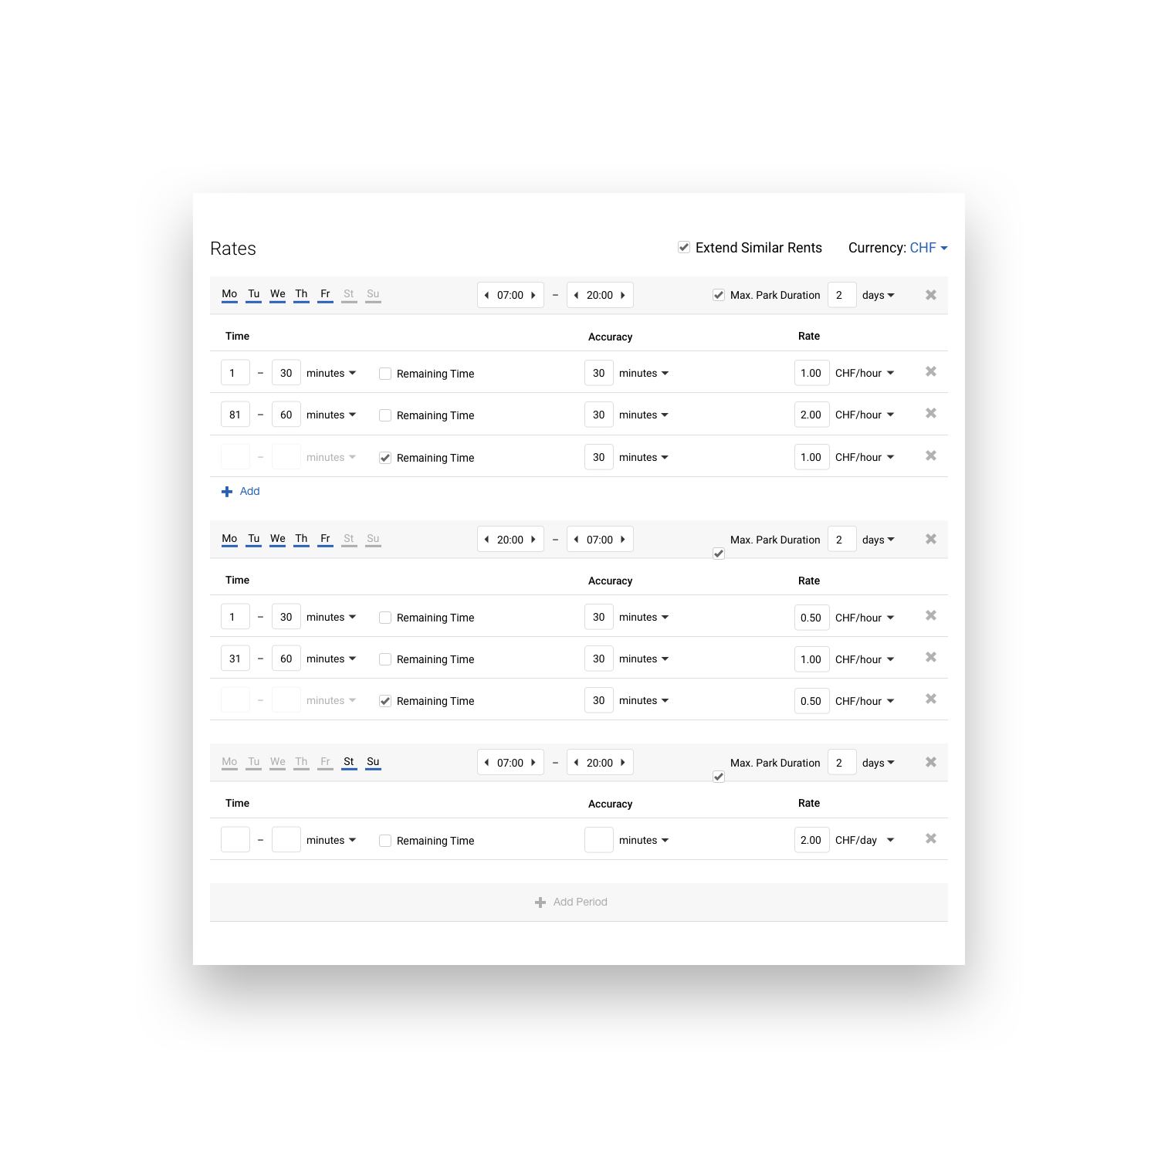
Rates
Main Functionality of the Platform UniP
Create your own rate and use predefined ones
Change prices remotely to improve monetization and parking loading

Slide 48




Billing
Main Functionality of the Platform UniP
Use popular and reliable payment and top up instruments: PayPal, Google Wallet, Apple Pay, PayMaster, SMS
Monthly passes
Daily tickets
Campaigns
Discounts
Set discreteness payment (pay for each 15 minutes, for example)

Slide 49
Statistics and Reports
Main Functionality of the Platform UniP
Analysis of the parking space occupancy and development of proper parking solutions with regard to dynamic fare, parking time, etc

Slide 50
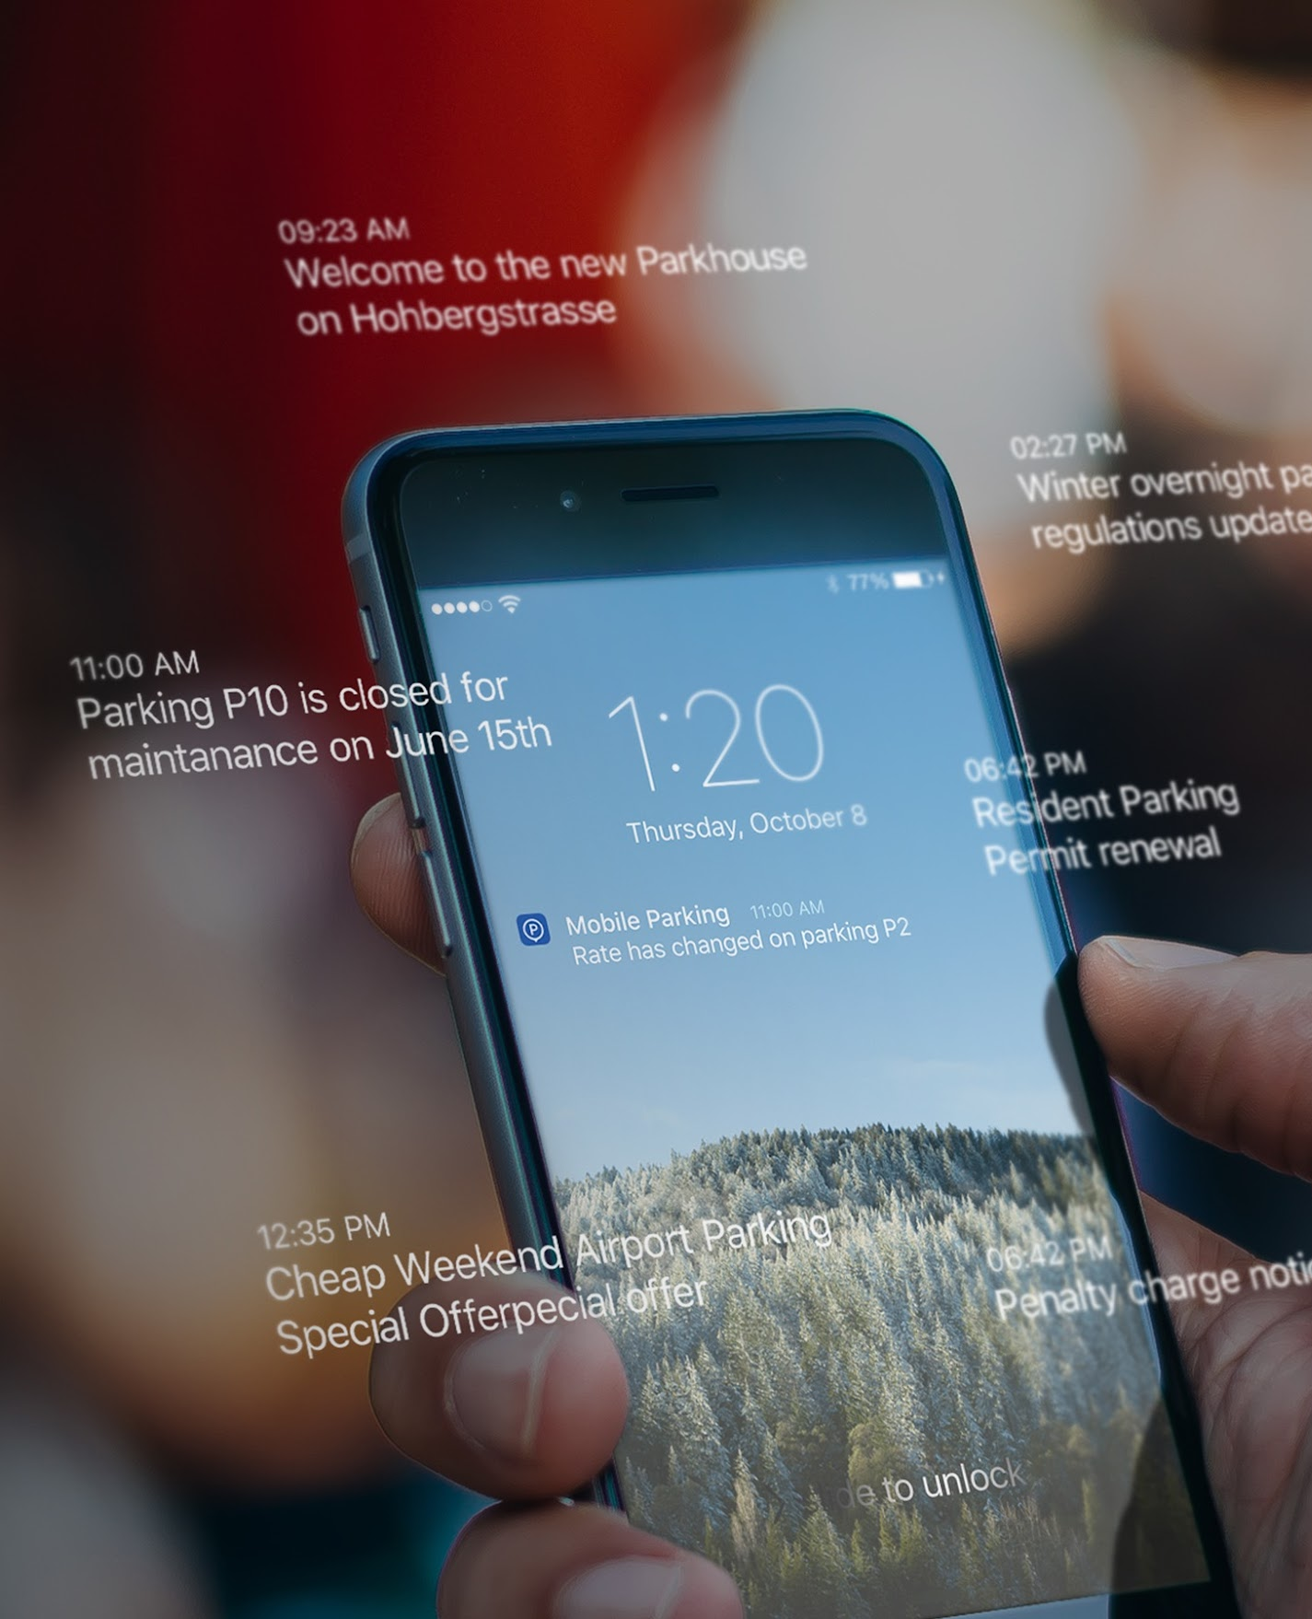
Notification and Feedback
Main Functionality of the Platform UniP
Automatic push notification about fares and conditions, special offers, etc

Slide 51



Integration
Main Functionality of the Platform UniP
Automatic integration possibility with parking meters, payment terminals and other systems

Slide 52
Integration
Main Functionality of the Platform UniP
Pay for the parking in Park House via mobile app.

Slide 53
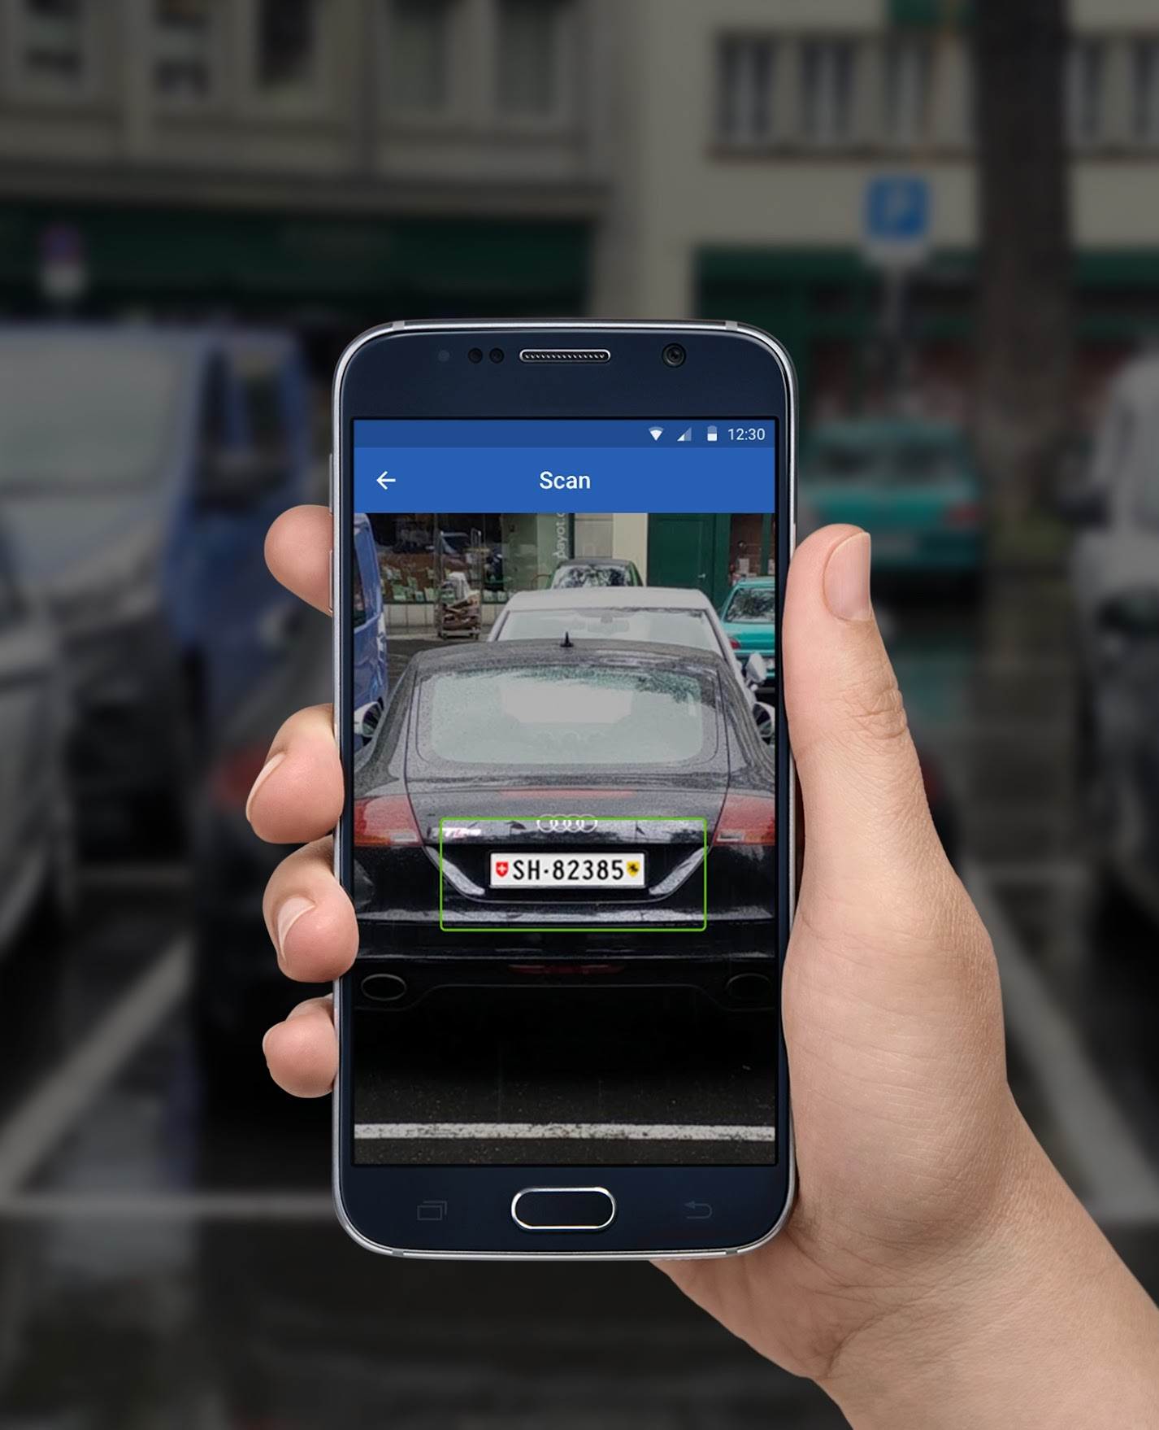
Monitoring
and fines
Main Functionality of the Platform UniP
Automatic detection of car license plate
Special application for the controller
Photo / Video fixation
Integration with mobile printer
Automatic customer notification
Pay a fine remotely

Slide 54
Thanks

